Slide 2
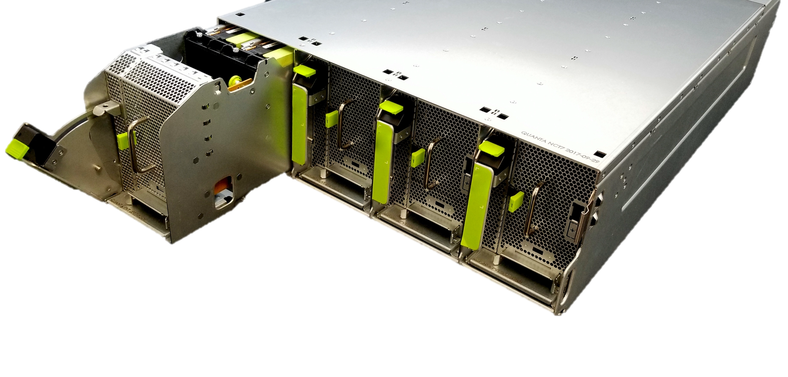
Yosemite V2 –
Modular 1S Platform
Damien Chong, Hardware Engineer, Facebook
Anthony Chan, Electrical Engineer, Facebook

Slide 3
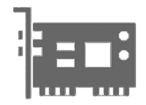

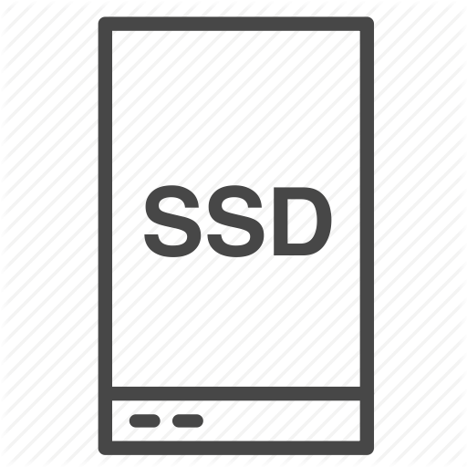

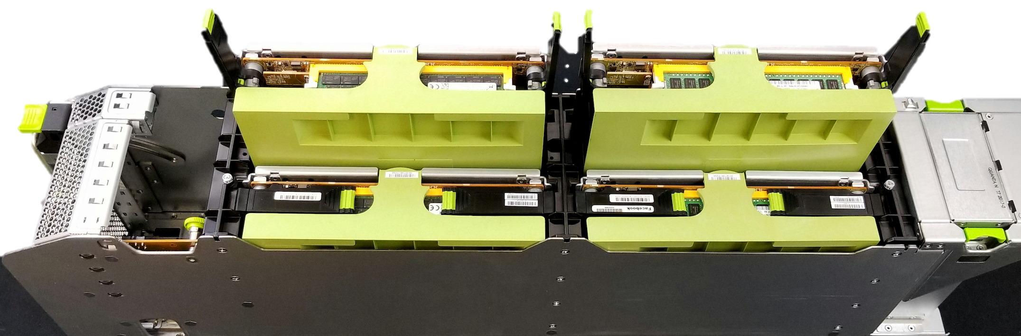
Yosemite V2: Modular platform
OpenRack V2
PCIe CEM
Crane Flat
50Gbps
MH NIC
6x M.2
Glacier Point
M.2
Hot Service
100Gbps
MH NIC
Intel
x86
Twin Lakes
Intel
x86
Twin Lakes
Dual ODM
EMI
& Safety

Slide 4
Yosemite V2: Spec changes
Updating SVR_ID0 / GPIO0 definition to scale the platform supporting more cards.
Old definition |  | New definition
< 1.0v | Smart SoC card | < 0.44v | Smart SoC card
 |  | 0.7v +/- 0.25v | Smart device card
1.2v +/- 0.2v | Crane Flat PCIe CEM carrier card | 1.2v +/- 0.25v | Crane Flat PCIe CEM carrier card
1.7v +/- 0.2v | Glacier Point 6x M.2 carrier card | 1.7v +/- 0.25v | Glacier Point 6x M.2 carrier card
BMC ping Bridge-IC on Smart SoC card for identification
BMC read Smart device card I2C address 0xA2 EEPROM for identification

Slide 5
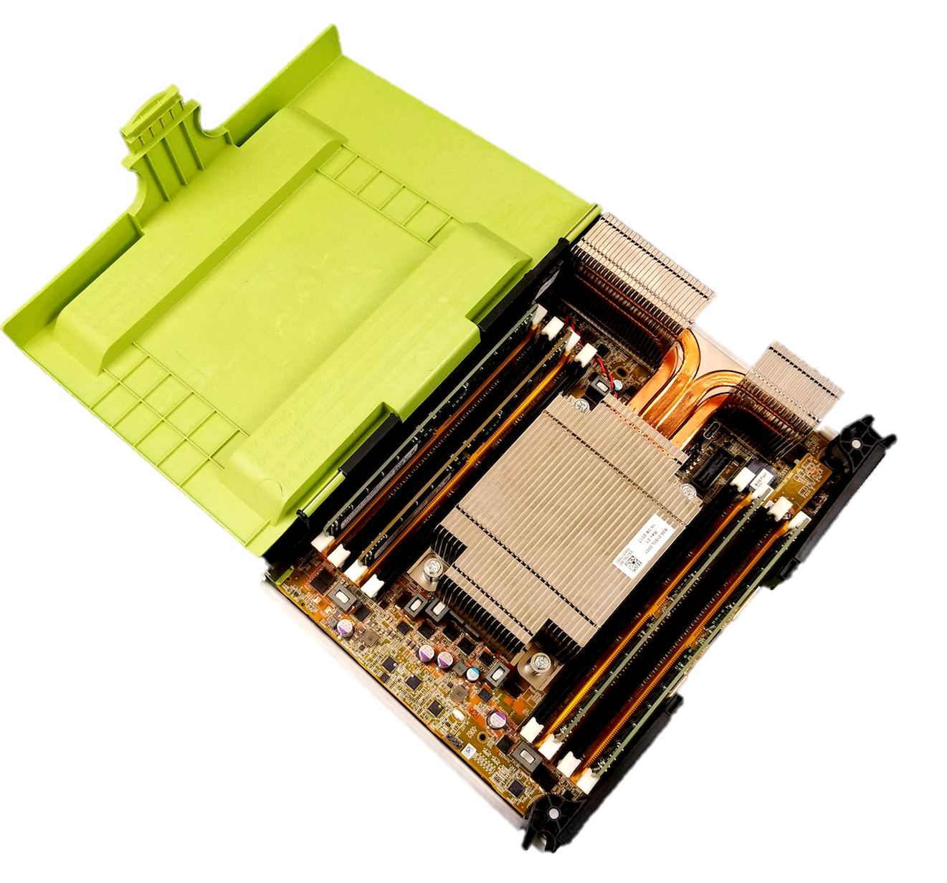
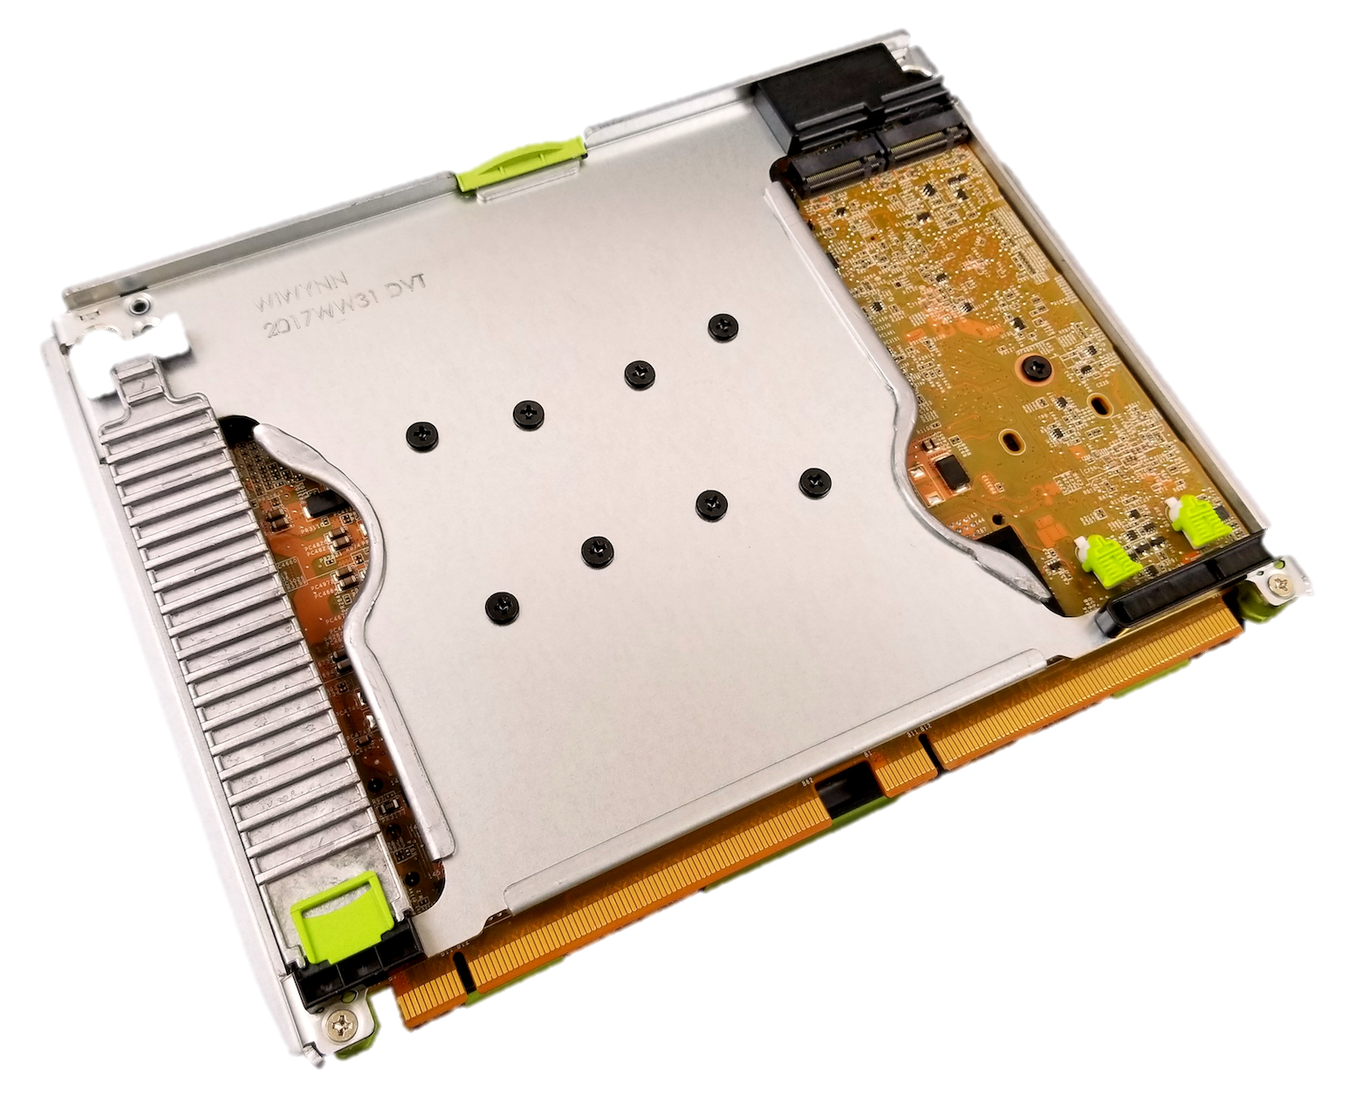
1S compute: Twin Lakes
SoC | Intel Skylake-DE 18-cores
Memory | 4-channel 2DPC DDR4 2400
Boot drive | 1x 2280 PCIe Gen3 M.2
Expansion | 2x 22110 PCIe Gen3 M.2
Spec compliance | Twin Lakes 1S OCP spec

Slide 6
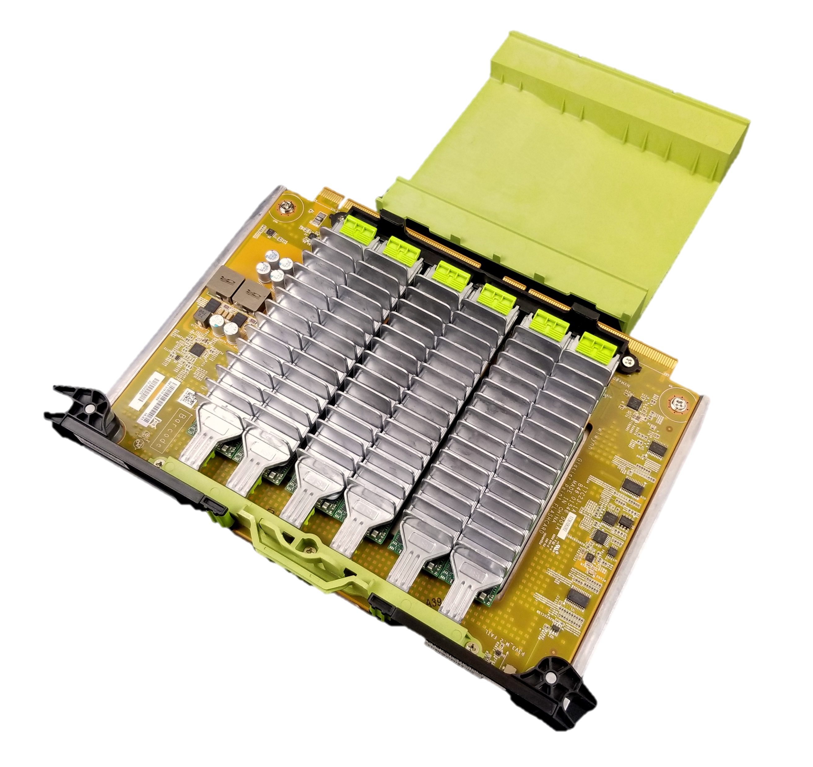
M.2 carrier card: Glacier Point
Glacier Point v1 | 6x PCIe Gen3 22110 form factor
Next generation: Glacier Point v2 in concept | 12x PCIe Gen3 22110 form factor with PCIe switch

Slide 7
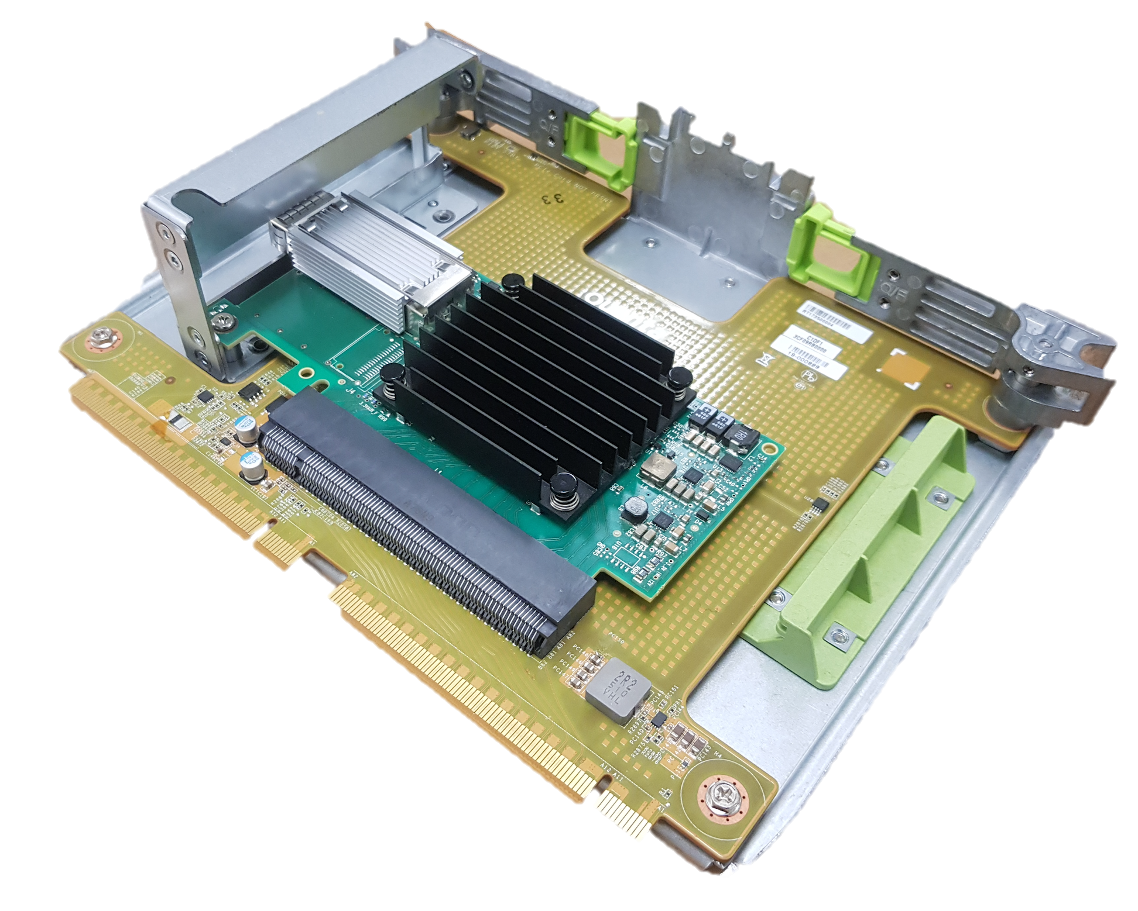
PCIe CEM carrier card: Crane Flat
Crane Flat | Half width full height PCIe x16

Slide 8

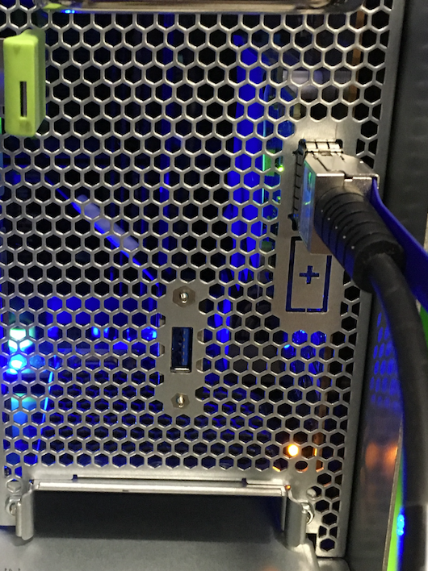
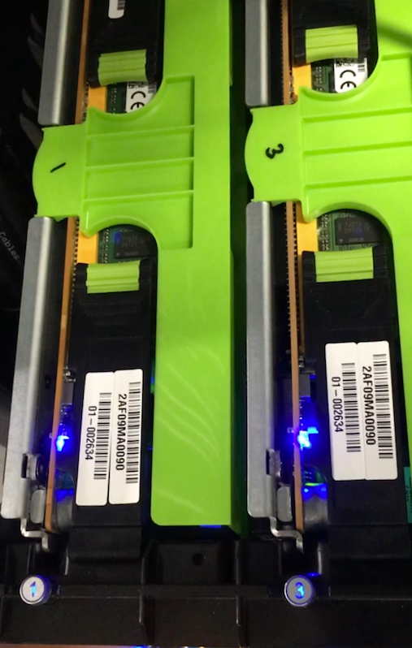

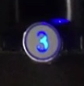
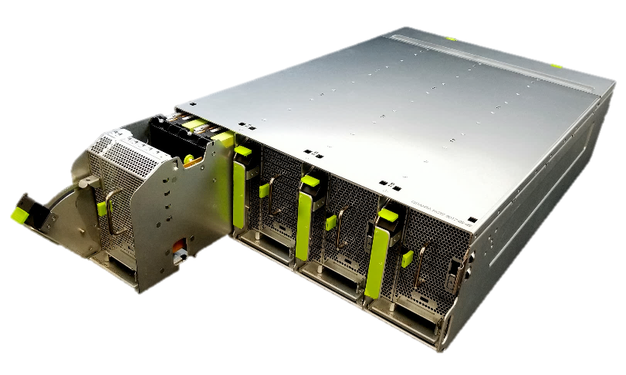

Hot service: Removal card for service only impact individual compute node
Card removal:
Trigger service event
Power down card(s)
Sled front panel LED blink
Pull-out sled
Card to be serviced slot LED blink
Remove the card
+
BMC out-of-band
USB debug card
Card insertion:
Insert the card
Power up
card(s)
Card LED stop blinking
Push-in sled
Service event complete

Slide 9

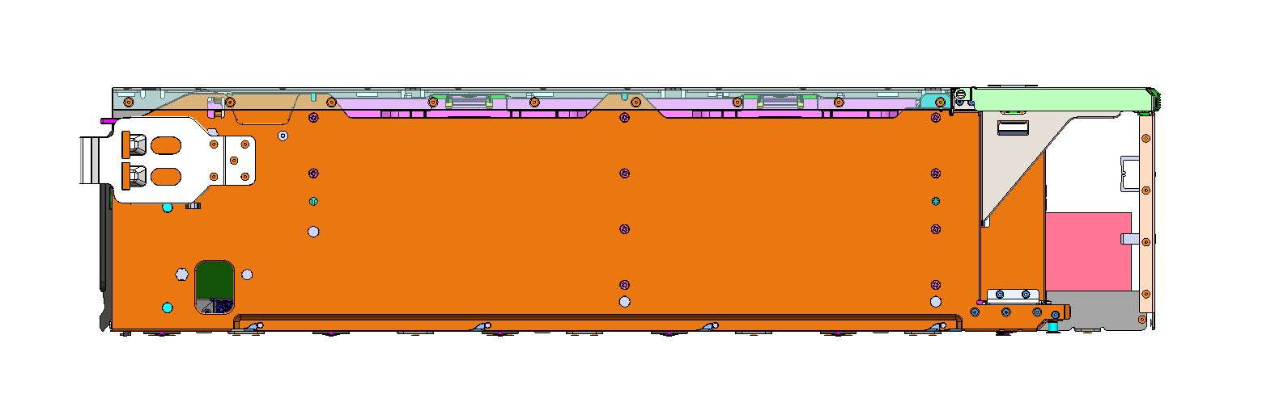
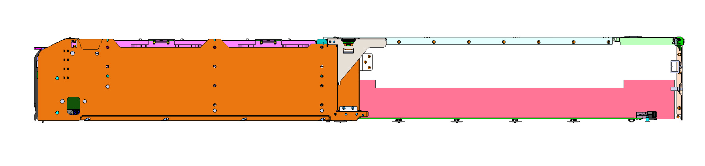
Hot service: Enabling from design perspective
High-level goals
  Solution is seamless from operator perspective
  Minimize power loss during normal operation
  Mechanism to prevent cascading failures
Main electrical components
  E-brush connector
  Power bar PCB
Sled pushed in during normal operation
Sled pulled out during hot service

Slide 10
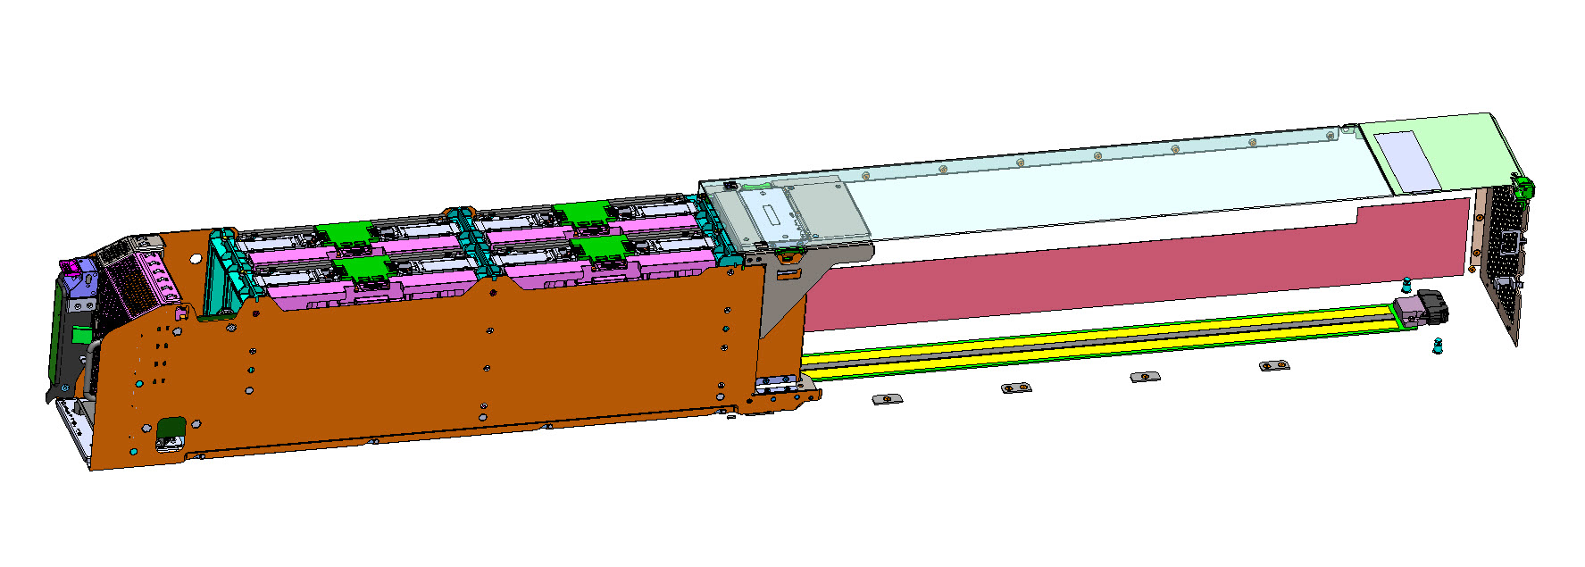
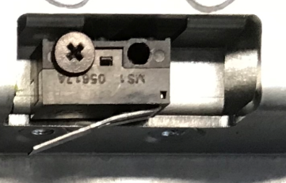
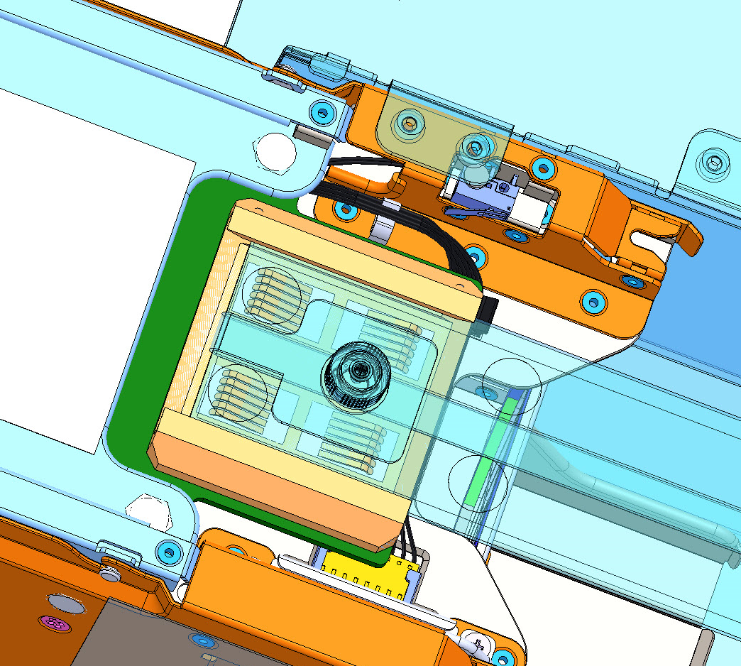
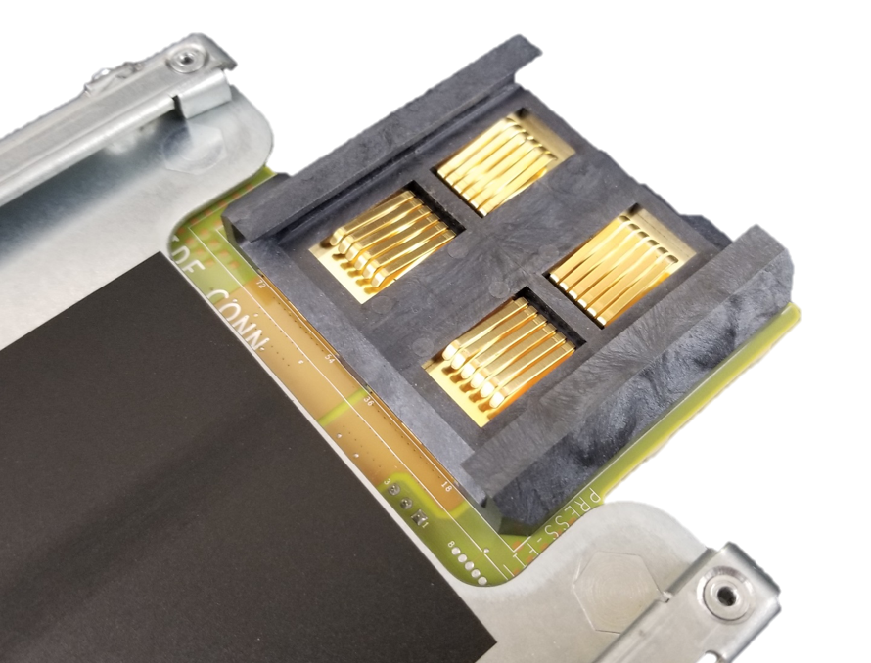
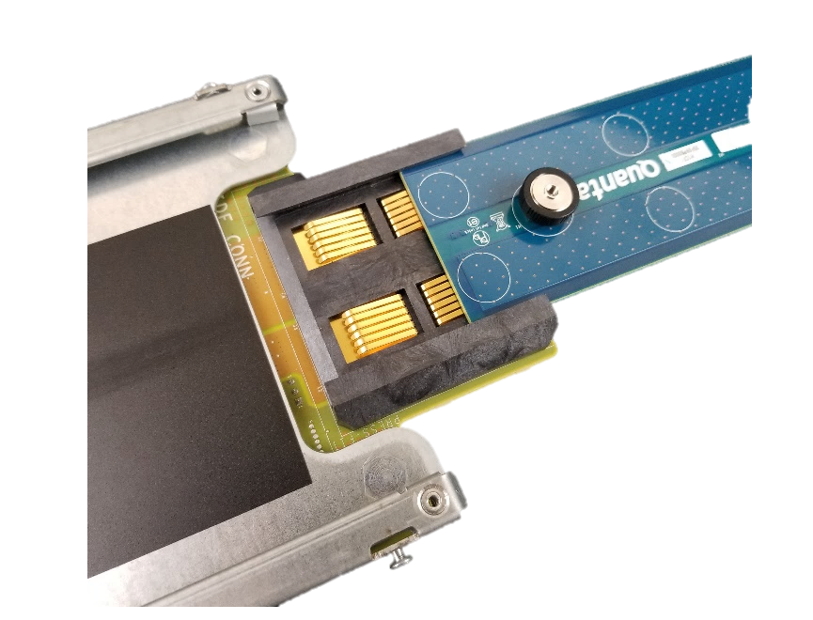
Hot service: Enabling from design perspective
Fan latch toggle switch
Underside view of sled
E-brush connector mounted on baseboard
Gold-to-gold contact between e-brush and power bar PCB

Slide 11
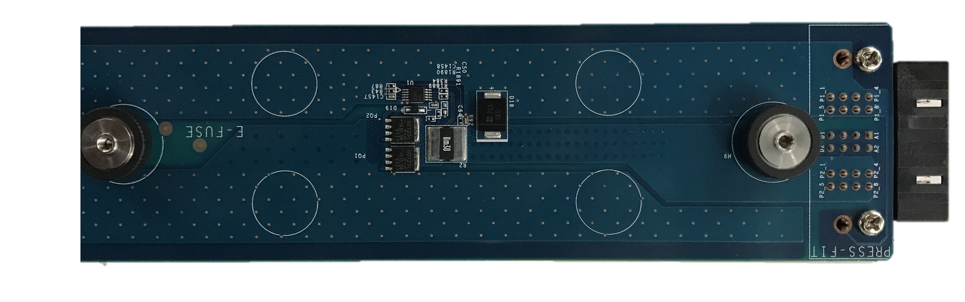
Hot service: Enabling from design perspective
Over current protection threshold | ~ 70A
Added power loss (12V @ 50A) | < 2W
Auto retry after fault support | Yes
Power bar PCB w/ e-fuse protection

Slide 12
Learn More About Yosemite V2
Yosemite V2 OCP specification here
Twin Lakes OCP specification here
Visit the Facebook booth located at A13 to learn more

Slide 13

Notes:
Big picture taking all the slide, with no text

