Slide 2
Failure Prediction Mechanism for Pluggable Optical Interconnect at Facebook Data Centers
Abhijit Chakravarty and Vincent Zeng

Slide 3
Problem Statements
Currently there is no method developed to avoid the optical transceiver failures ahead of time. Network traffic loss is not predicable

Slide 4
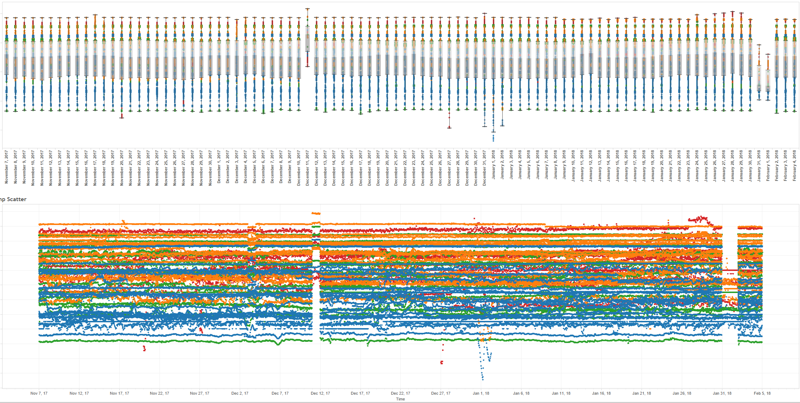
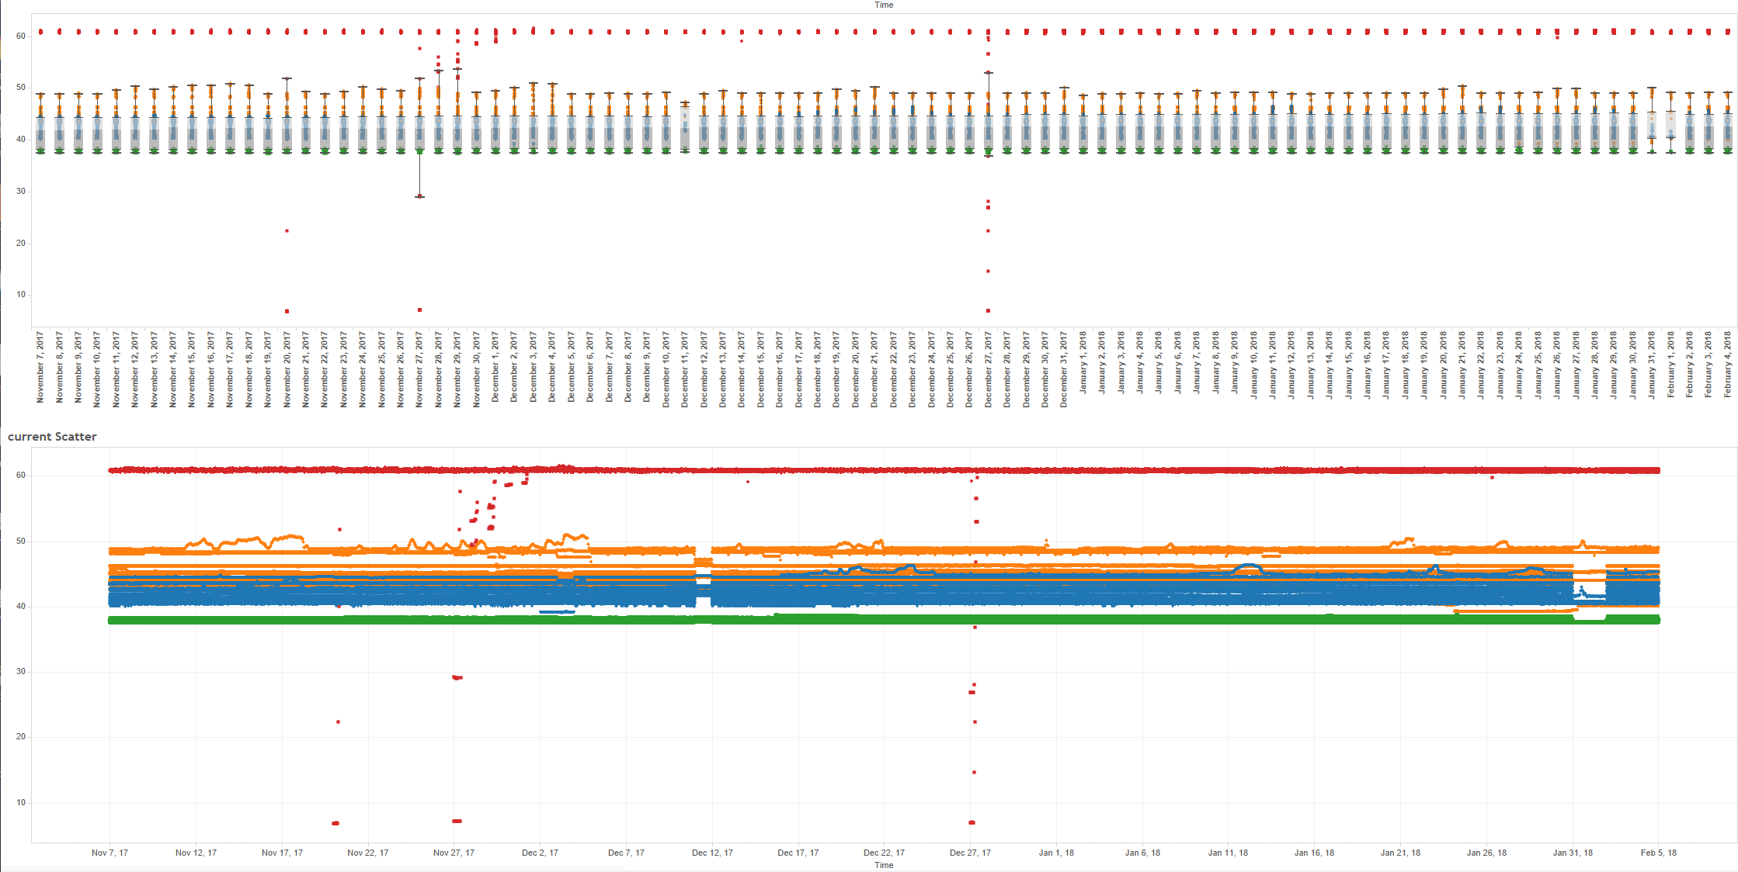
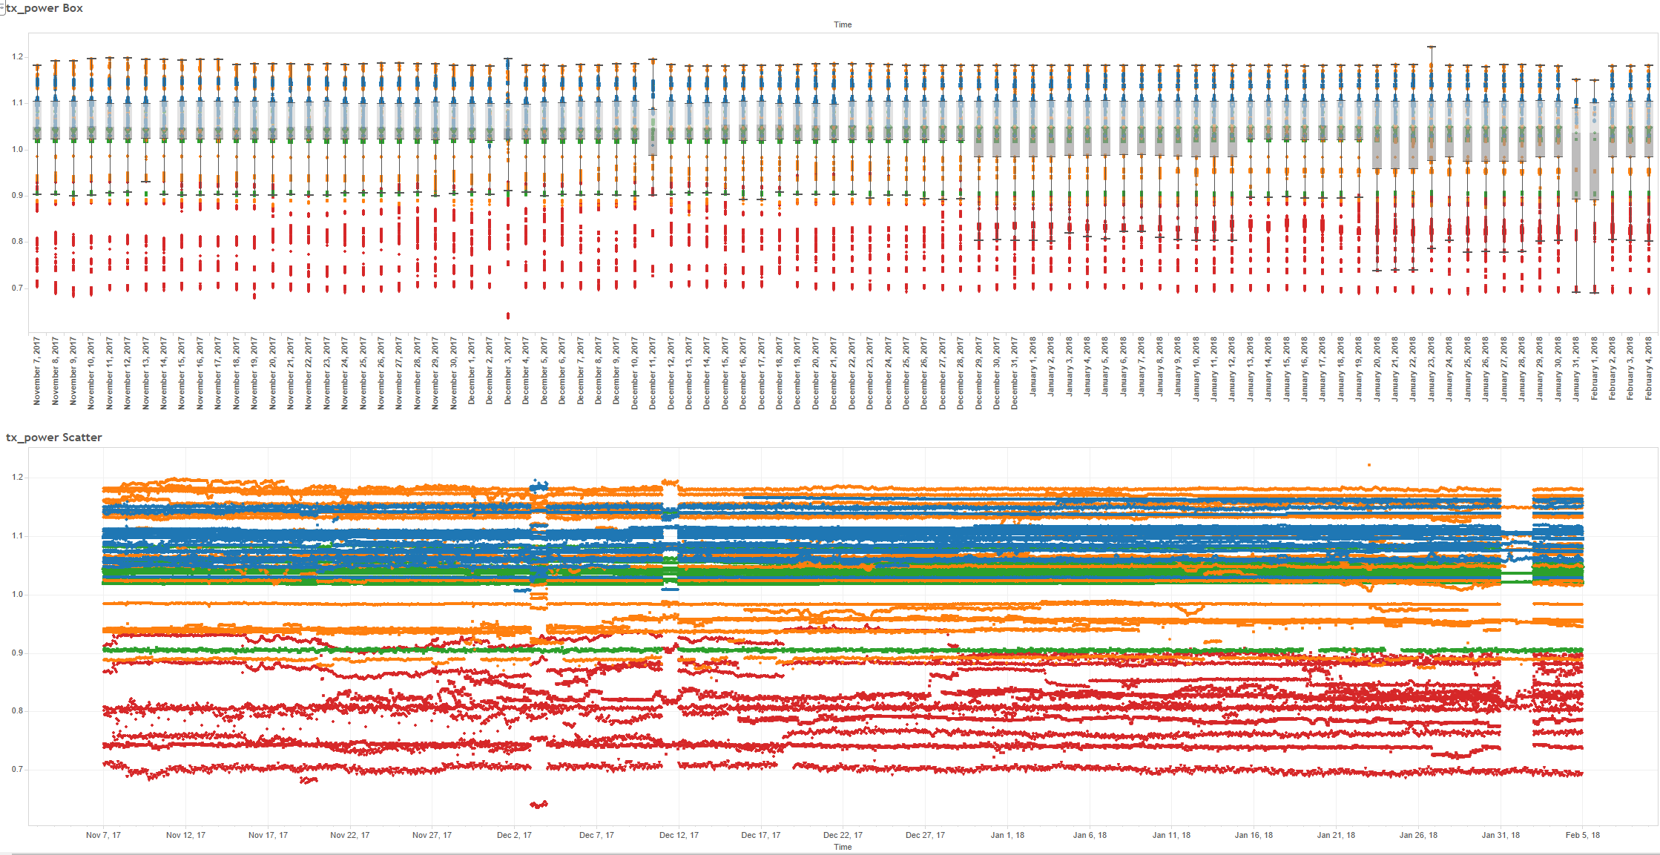
Real-time performance monitoring mechanism at FB data centers
Temperature Readout
Tx Bias Current Readout
Transmitter Power Readout
By data centers
By suppliers
By part number
By switch port
Over time
All switch platforms (RSW = rack switch, FSW = fabric switch, ESW = edge switch, SSW = spine switch)
Temperature, Tx Bias, Tx Power, Vcc, Rx Power

Slide 5
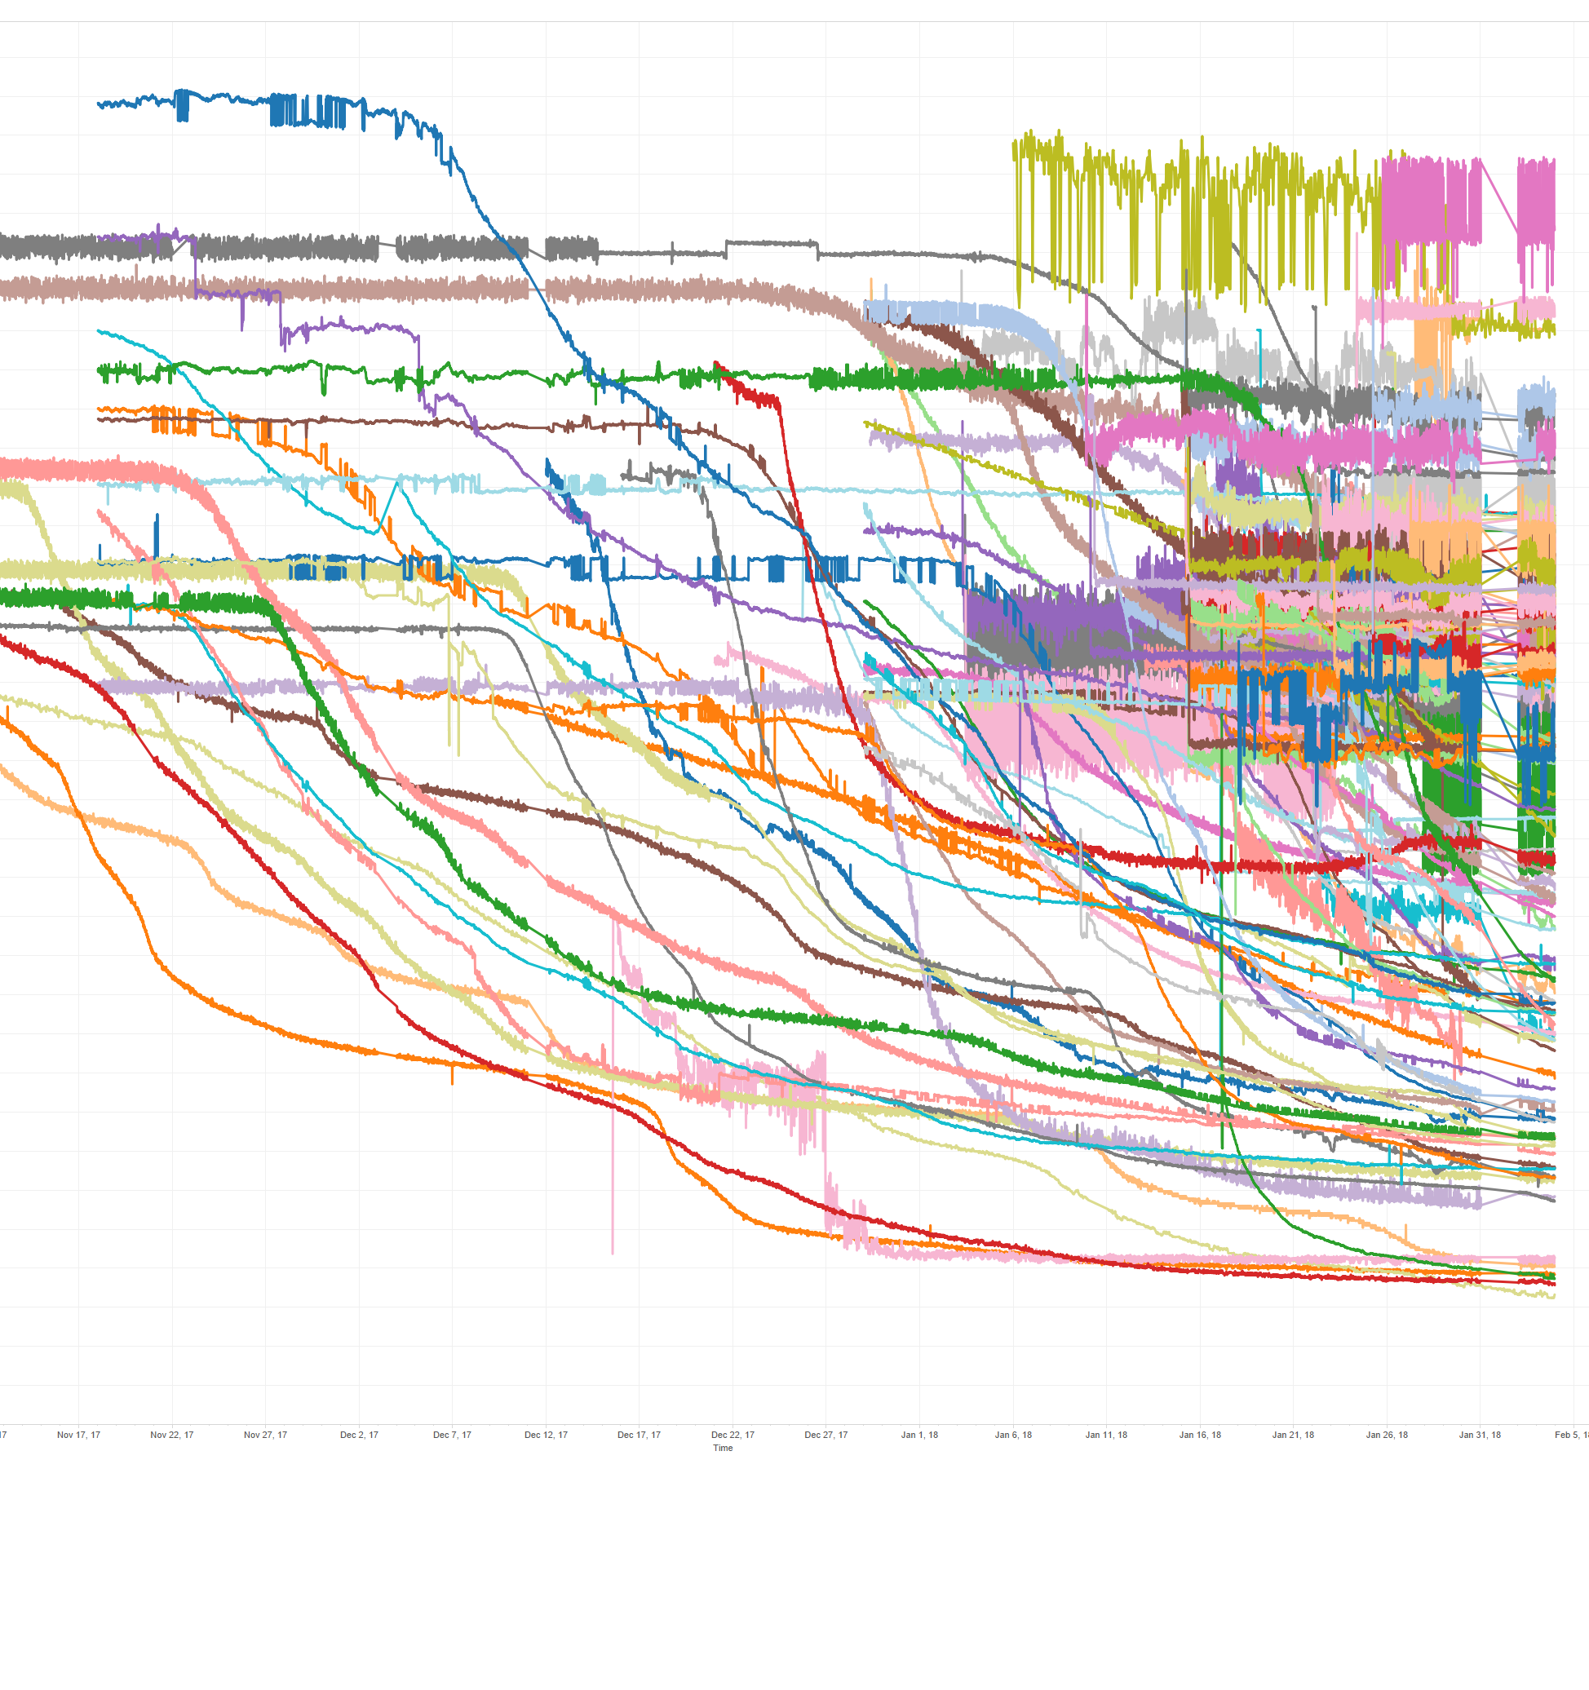
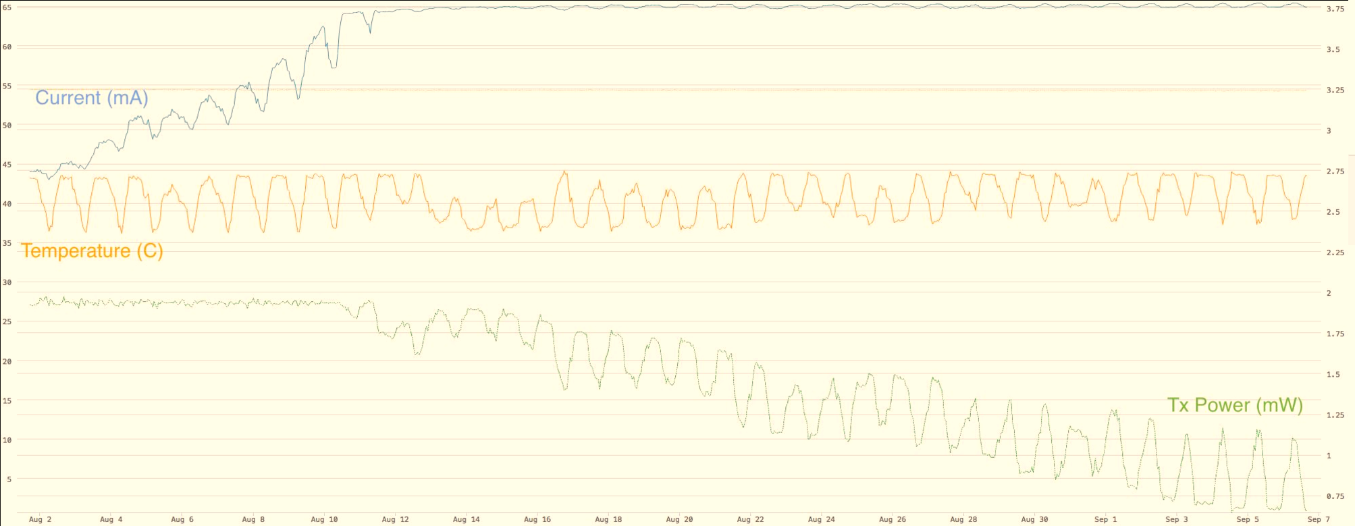
Real-time monitoring mechanism implementation at our DCs
Shows the relationship between tx/rx power, current, and temperature
As a transceiver degrades/begins to fail, current gradually increases to maintain steady Tx Power, until reaching a plateau at 65mA (depends on supplier)
Beyond the plateau, recovery is impossible and the particular transmitter will likely fail in a few
Also, the case temperature has a positive correlation with transmitter bias current and negative correlation with transmitter optical power
This correlation can help us better predict the failures and prevent the link failure in a data center before it actually occurs

Slide 6
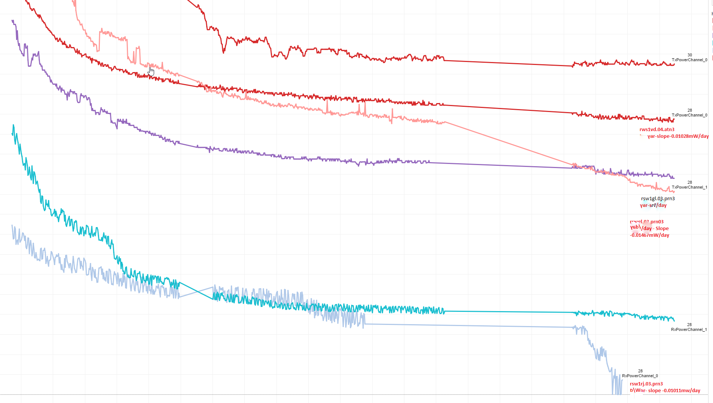
Failure Modes Observation
~20 units were pulled
All of them failed after stressful test within two weeks

Slide 7
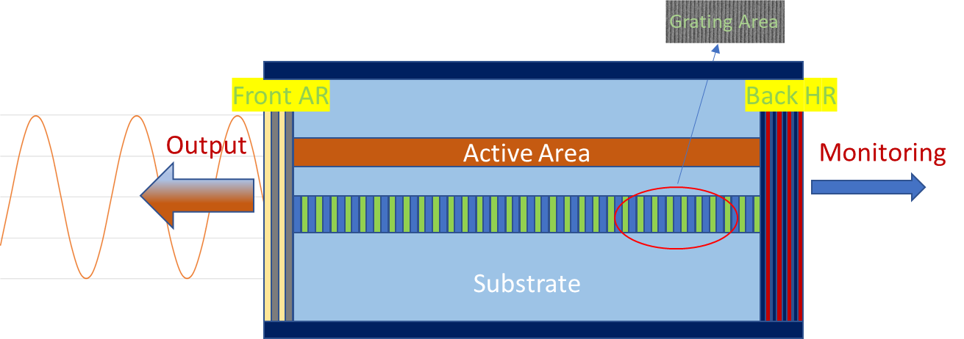
Some Basic Of Laser Diode Failures
Power Reduction
Wavelength shift
Spectral linewidth widening
Modulation speed change
No lasing suddenly
Defect/dislocation propagates
Metal diffusion/mitigation. Defect propagates
Grating area disorder/precipitation/facet melting
Defect propagates/grows
Bonding part/alloy reaction/thermal fatigue

Slide 8
Algorithm Proposed
The adjustment of the sensitivity of top power monitoring (TPM device)
Need to set the algorithm to find out the saturation of Tx power output.

Slide 9
Conclusions
We investigated the correlation among the bias current of the laser diode, transmitter power degradation and environmental changes.
We identified signatures for laser diode degradation
We are developing a mechanism to predicate the failure modes.

