Slide 2
100G CWDM4-OCP Update
Interoperability
Assurance of Supply at DC Scale
Quality and Reliability
Abhijit Chakravarty, Heidi Daniels, and Vincent Zeng
Notes:
Add FB logo –

Slide 3
Supply Focus at DC Scale
Notes:
Hi Everyone,
My name is Heidi Daniels, and I’m a Sourcing Manager for the Network Hardware team at Facebook. A few weeks ago I decided to start hiking locally and a friend of mine had recommended trying the PG&E trail at Rancho, San Antonio Park. I’d never been before – but hiking is walking – so how hard could it be, right?
So I packed my camelback and put on my hiking shoes to prepare for the morning and I started out. Within the first 10 mins, I started to climb and the climb was intense. And then the climb continued… and continued. So an hour later, I was truly relieved to get to a plateau, catch my breath and look back over the beautiful view. Of course in my mind – I’m hoping that the climb was done because I was ready to start heading down for a change - but once I turned back to the path – there was still a great deal more climbing needed.
I know you didn’t all come here to learn about me and my hiking regimen – but this is a similar story to what we’re seeing with our data center growth…

Slide 4
Supply Focus at DC Scale
Interoperability
Assurance of Supply
Quality and Reliability
Notes:
Now – comparing my hike to our 100G CWDM4 needs over the past 2 years – when we stop and look back at the how we’ve needed to grow and scale, we’re all amazed and proud with how far we’ve come. And then we turn around and look to the future – and we’re consistently challenged with how to get up the next big hill.
Supply for 40G & 100G Optical transceivers was a challenge in 2016 and 2017, so we wanted to do something differently for the future.
Mid year 2017, we used the OCP philosophy of getting more eyes on the problem by sharing this growth projection with our qualified and interoperable Suppliers and asked for their guidance to help us meet the challenges ahead. Our focus was and continues to be assurance of supply with committed capacity to meet our significant growth for the foreseeable future. It’s also critical that our Partners work with us to continuously improve their quality and reliability, while remaining open and responsive in this partnership.

Slide 5
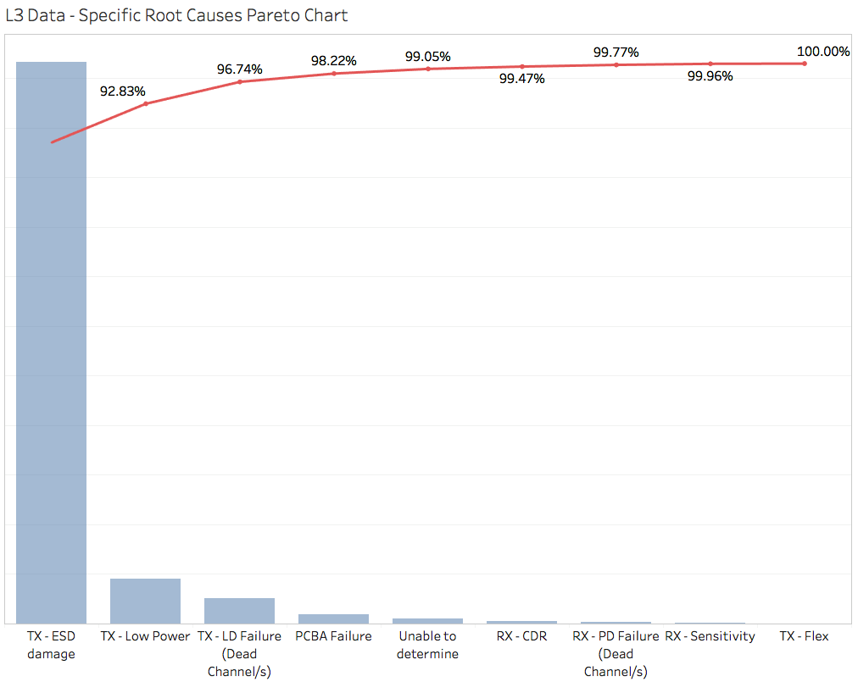
Post-Production Failure Modes: Laser Failures

Slide 6
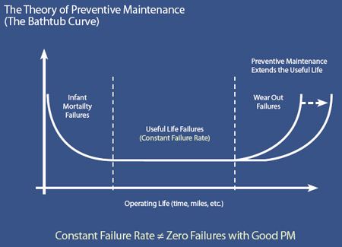
Process Improvements - More Automation
More stressful burn-in for the laser die
Assembly automation
                Move to more wafer-level integration (PIC)
                Optical alignment automation for both Tx/Rx sides
                Handling parts with automated processes

Slide 7
Portable Field Troubleshoot Tool
Design Spec Brief
Portable device
QSFP TRx DOM status monitor
PRBS capability options
R/W EEPROM
      Power: rechargeable battery preference
      QSFP cage: adapter is under consideration
      GUI: programmable with pass/fail criteria
      Display: LCD
      Device safety compliances

Slide 8
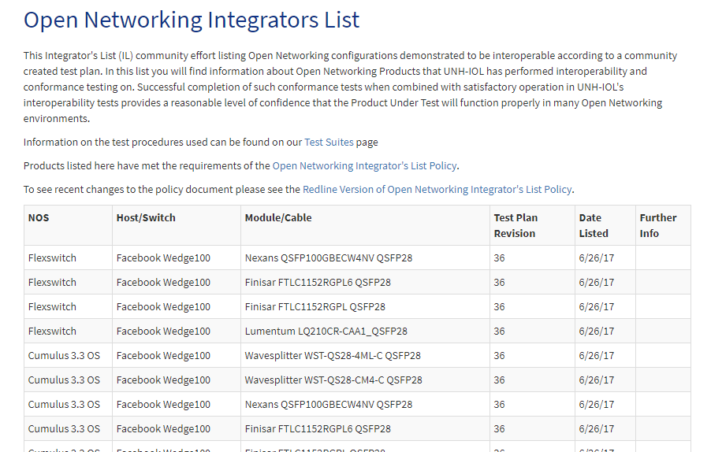
UNH IOL: Integrator’s List
UNH-IOL began working with the Open Networking group in 2015
5 Open Networking Plugfests held at UNH-IOL
Over 120 SKUs posted to the Integrator’s List
UNH-IOL maintains Open Networking Integrator’s List

Slide 9

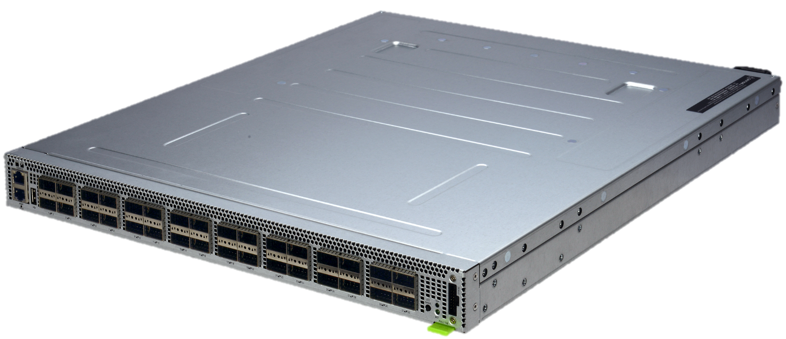
UNH Interoperability Laboratory
Facebook partners with UNH IOL to allow transceiver vendors to qualify their modules on the OCP Wedge 100 platform
35+ SKUs validated so far, with more on the way
  AOC – 10 SKUs
  DAC – 8 SKUs
  Optical – 22 SKUs
Wedge 100

