Slide 2
Standards-based
Multi-Host NIC Management
Sai Dasari, Facebook
Hemal Shah, Broadcom Limited
Yuval Itkin, Mellanox Technologies

Slide 3
Agenda
OCP NIC Background
Configuration/Control/Monitoring
NIC F/W update
Summary

Slide 4
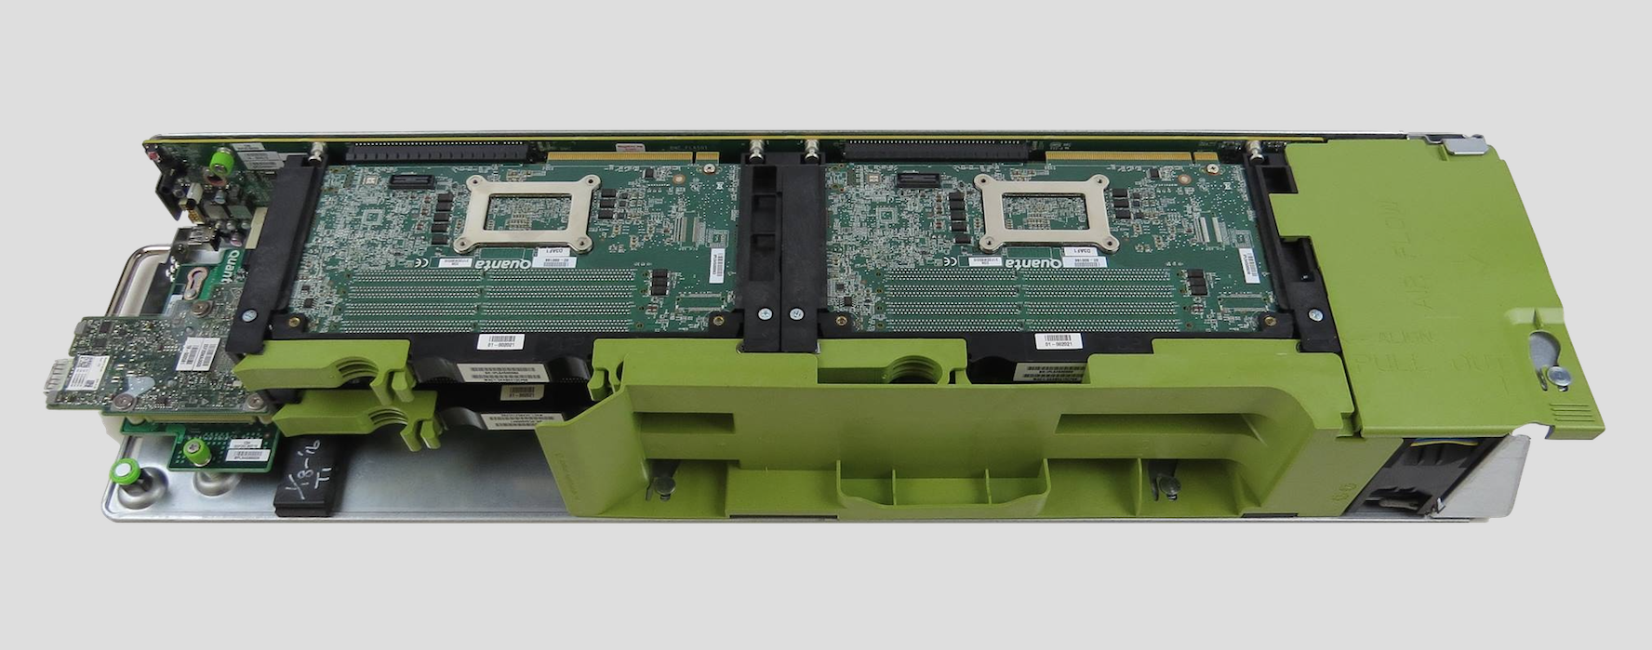
Multi-Host Yosemite OCP system

Slide 5
Multi-Host Yosemite topology
Slot4
Slot3
Slot2
Slot1
OCP V2
Multi-Host
NIC Mezz
PCIe Gen3 X4
1S Server
QSFP28, 2 lanes
50G
Management
NC-SI/RMII or SMBus
BMC

Slide 6
Background: Why OCP NIC?
System Level Design Factors
    1G->10G->25G->100G-> …
    Compact Form Factor
    Available Standard PCIe slots
    Support Multi-Host Environments
    Side-Band connectivity (I2C, RMII)
    Standby Power Domain
    Smart NIC Advanced Feature usage
Networking Options
    CPU complex Built-In NIC
    External On-board NIC
    Standard PCIe NIC card
    Build Open Standard?

Slide 7
OCP NIC evolution
OCP Spec v0.5 (2012)
    10G
    X8 PCIe Gen3
    I2C Sideband
    2x SFP
OCP Spec v2.0 (2015)
    10G/25G/40G/50G/100G
    X16 PCIe Gen3
    I2C and RMII sideband
    Upto 4x SFP28, 2xQSFP28, 4x RJ45
OCP Spec v3.0 (WIP)
Industry Adoption (public)
  Broadcom Limited
  Chelsio
  Intel
  Mellanox Technologies
  Qlogic
  Quanta
  Silicom
  WiWynn
  Zaius (Rackspace/Google)

Slide 8
NIC management use cases
    Pass-through Management traffic control
    Inventory of NIC capabilities and parameters
    Port link status reporting and NIC Statistics
    Notifications: driver presence state changes, link status change, soft reset, etc.
    Inventory of provisioned BMC MAC addresses
    Temperature reading
    Inventory and configuration of host PCIe functions
    Firmware inventory (versions of images, firmware package string) and update

Slide 9
MH specific management use cases
    BMC MAC Address Provisioning
    NIC provisions MAC addresses for BMC or virtual BMC (one per host)
    BMC MAC addresses are retrieved via NC-SI commands
Host-BMC configuration and control
    Each host has independent communication channel with the BMC
    Host-BMC communication is configured and controlled by the BMC
QoS Configuration and Control - All hosts share NIC port bandwidth
    Port bandwidth settings controlled by the BMC via NC-SI commands
    Bandwidth settings configured per NC-SI channel (physical network port)

Slide 10
Network Controller Sideband Interface (NC-SI)
    A common interoperable sideband interface and protocol defined by the DMTF
    NC-SI Communications
        Pass-through Management Traffic
        NC-SI Command/Response Packets
        NC-SI Notification Packets
    NC-SI enables standards based management
    NC-SI OEM commands allow NIC implementation specific extensions

Slide 11
NC-SI/RBT and NC-SI/MCTP/SMBus
NC-SI over RMII Based Transport (RBT)
        Defines NC-SI Binding over Reduced Media Independent Interface™ (RMII)
        Physical-level interface is based on RMII
        Media-level interface is based on Ethernet
        Uses a shared media, Multiple NCs use the same lines
        Defines arbitration scheme: Enables sharing a single RMII-based NC-SI bus
NC-SI over MCTP/SMBus
        Enables NC-SI communications over SMBus
        MCTP is used as base transport for NC-SI communications
        Physical Medium SMBus provides arbitration
        Hardware-based arbitration not needed

Slide 12
PMCI* components used by OCP NIC
Upper Layers
MCTP Control
Platform Level Data Model (PLDM)
Network Controller Sideband Interface (NC-SI)
Transport Layers
Management Component Transport Protocol (MCTP)
RMII Based Transport (RBT)
MCTP over SMBus
Binding
MCTP over PCIe VDM Binding
Physical Layers
SMBus
PCIe VDM
RMII
*Platform Management Components Intercommunications (PMCI) WG of the DMTF defines MCTP, NC-SI, and PLDM Standards

Slide 13
PLDM for FW Update
DMTF published DSP0267 1.0.0 - PLDM for Firmware Update Specification
PLDM for firmware update defines unified methods for
    A protocol and method for performing firmware updates over management sideband interface
    File-format
    Firmware Update control and query commands

Slide 14
PLDM for firmware update concept
An Update-Agent (typically a BMC) reads a standard-defined file, to provide each firmware device its firmware
A single file can include firmware for multiple devices in a system
Each firmware device is independently updated
The update sequence follows the order of the firmware content in the file
The standard requires sending commands from both the Update-agent to the Firmware device and also from the Firmware-device to the Update-Agent
As of this time, such operating mode can only happen on MCTP-based interfaces

Slide 15
PLDM for FW update operation

Slide 16
Allowing PLDM for firmware update over RBT
In order to enable using RBT for PLDM for firmware update NC-SI control should be enhanced
A new method allowing a NIC to send PLDM commands to the BMC is required
DMTF PMCI workgroup has published Work-In-Progress document
The new commands are due to be included in NC-SI revision 1.2.0

Slide 17
PLDM over NC-SI RBT commands
2 new commands + 1 AEN are being defined
  Query Pending NC PLDM Request
          Using this command the BMC can query for any PLDM commands that the NIC has to send to the BMC
  Send NC PLDM Reply
          Using this command the BMC provides the response to the NIC PLDM command that was read in (1)
  Pending PLDM request AEN
          A non-mandatory method which allows the NIC to notify the BMC about the presence of a new PLDM command to the BMC

Slide 18
OCP NIC 3.0 card in different platforms
OCP NIC 3.0 allow for multiple operating modes for a card
The card notifies the system about its supported operating modes
    The card encodes its capability on the PRSNT signals
    The card primary-connector’s PRSTNT signals are reflected also in serial scan-chain
The system notifies the card on the system configuration
OCP NIC 3.0 spec defines the expected outcome for each combination of card and system capabilities
    Support for 1Host 2Hosts and 4Hosts
    Support for 1Host with Single, Dual and Quad sockets

Slide 19
Summary
OCP 3.0 NIC spec using the DMTF Standards enable:
Multiple vendors to provide cards to the same platform
The same NIC to be used in different platforms
        The NIC automatically adjusts its operational mode according to the system in which it is installed
System designers, following OCP 3.0 Spec can leverage off-the-shelf solution

Slide 20

Notes:
Big picture taking all the slide, with no text

