Slide 2
Optimisation of the Open Rack through a DFMA lens to help scale roll out.
Derek Paul Winsor
Senior Design Engineer
Rittal

Slide 3
Contents
History of the Open Rack
Challenges faced in the early days
What is Design For Manufacture and Assembly (DFMA)
Examples of optimization
Outcomes

Slide 4
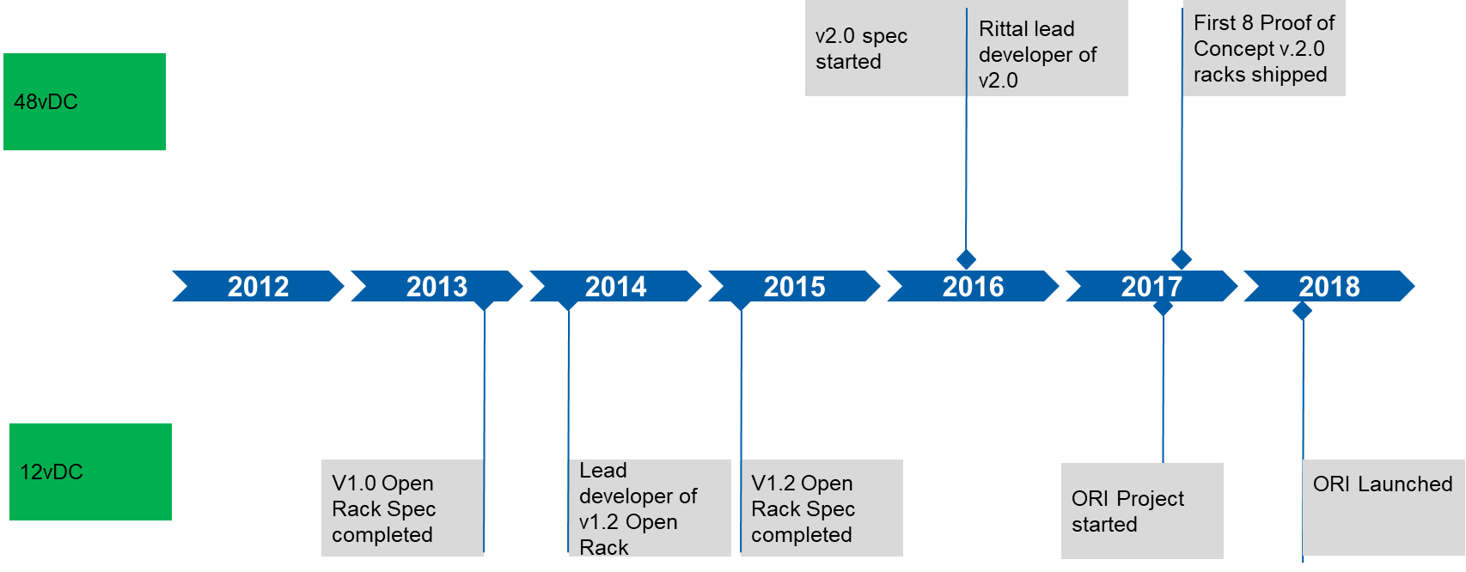
History of the open Rack
Timeline

Slide 5
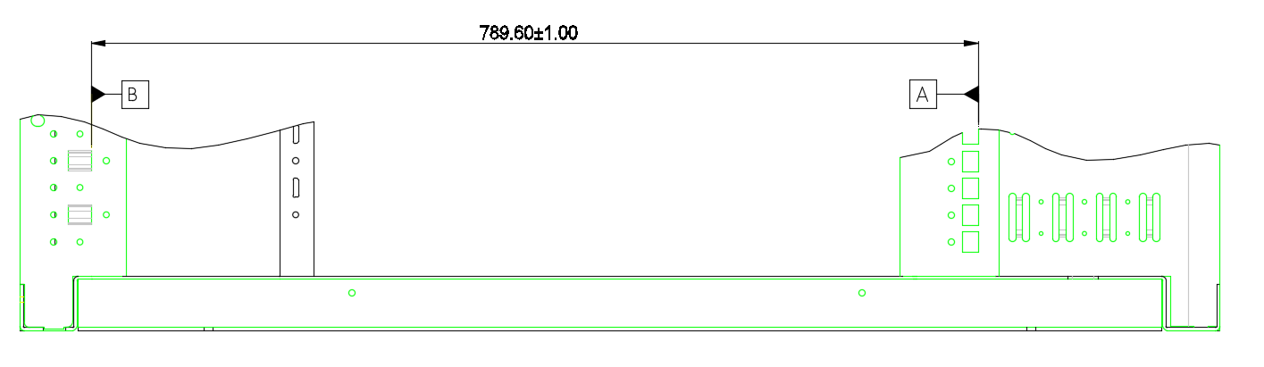
Challenges faced in the early days
Critical Depth dimension for equip. interface.
Yield
  First pass yield rates on key processes unacceptable
  Unacceptable levels of rework and waste in the process
Potential Field issues
  Outcome of the above statistically meant field issues were seen
  Meant field resolution, waste and ultimately cost
Repeatability
  Ability to hold processes capable to Cpk >1.33
  Assembly proved difficult, a lot of manual adjustments

Slide 6
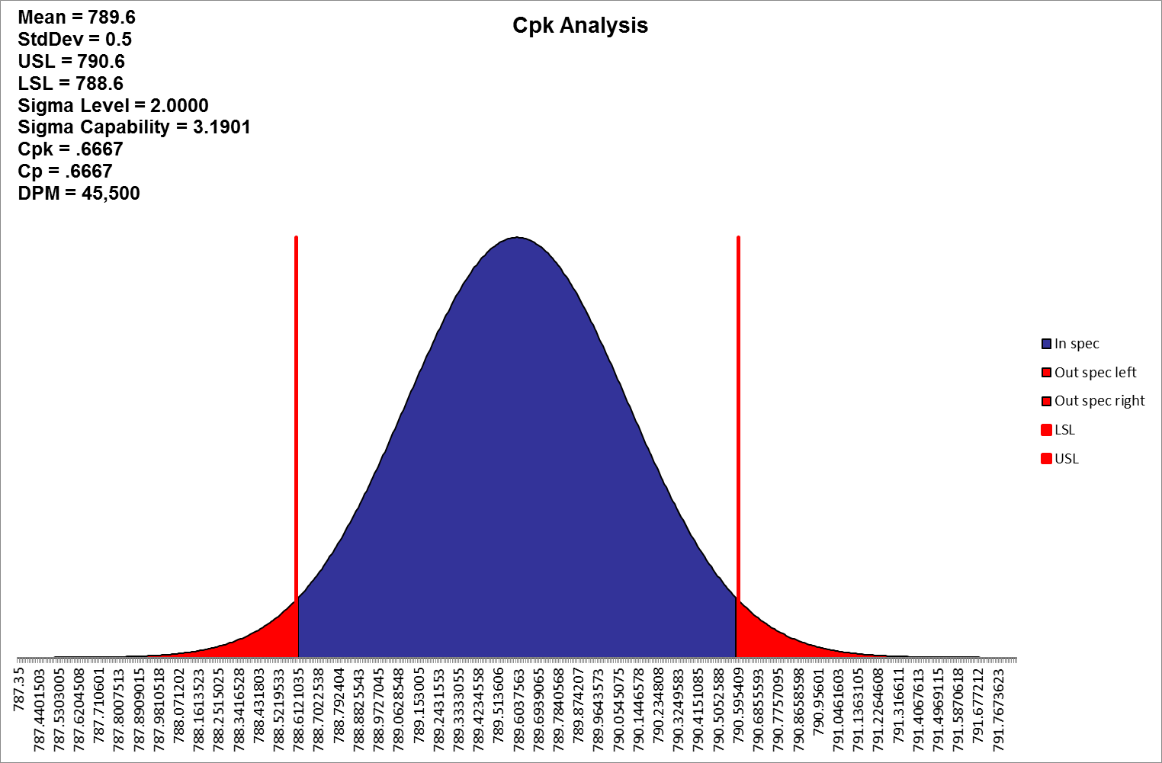
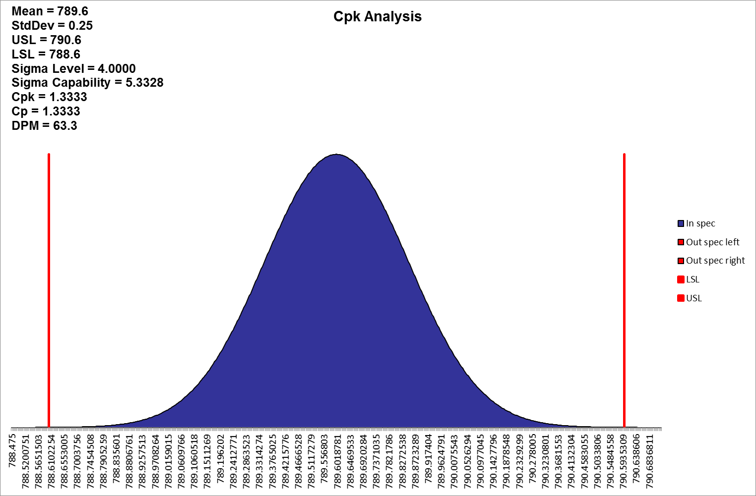
Challenges faced in the early days
Aim to achieve a good Cp (capable process) that is centered around the nominal Cpk (Cp=Cpk).
For volume manufacture Cpk ≥ 1.33

Slide 7

Design For Manufacture and Assembly(DFMA)
The goal is to achieve simple solutions in place of complex ones
Complex solutions tend to produce more waste
Waste can take the form of time, energy, labour, defective production, etc.
Historic Focus on Part cost reduction
Tendency to increase part count
Increase in potential defects
Increase in reliability and service issues.
Leads to
Simplification
of parts

Slide 8
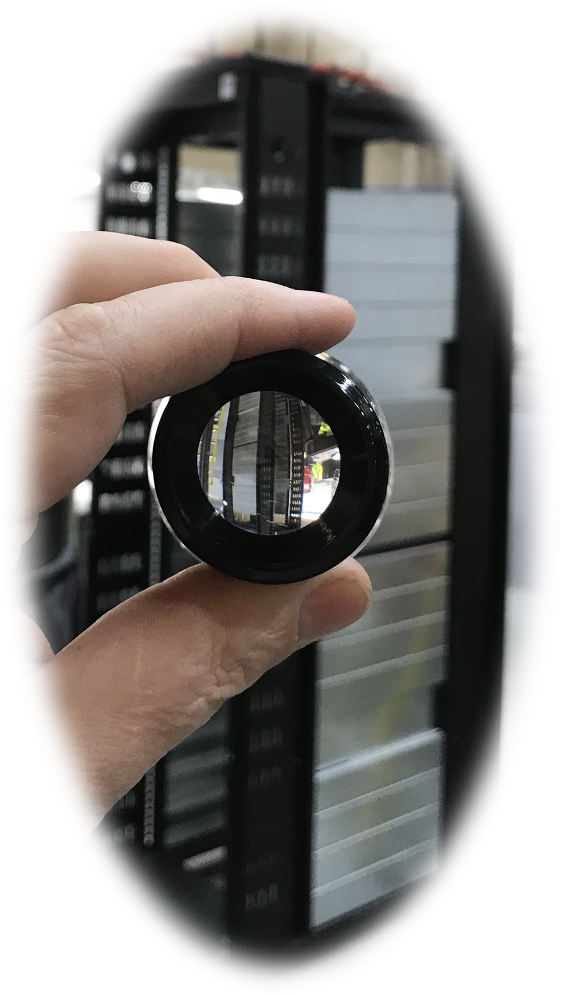
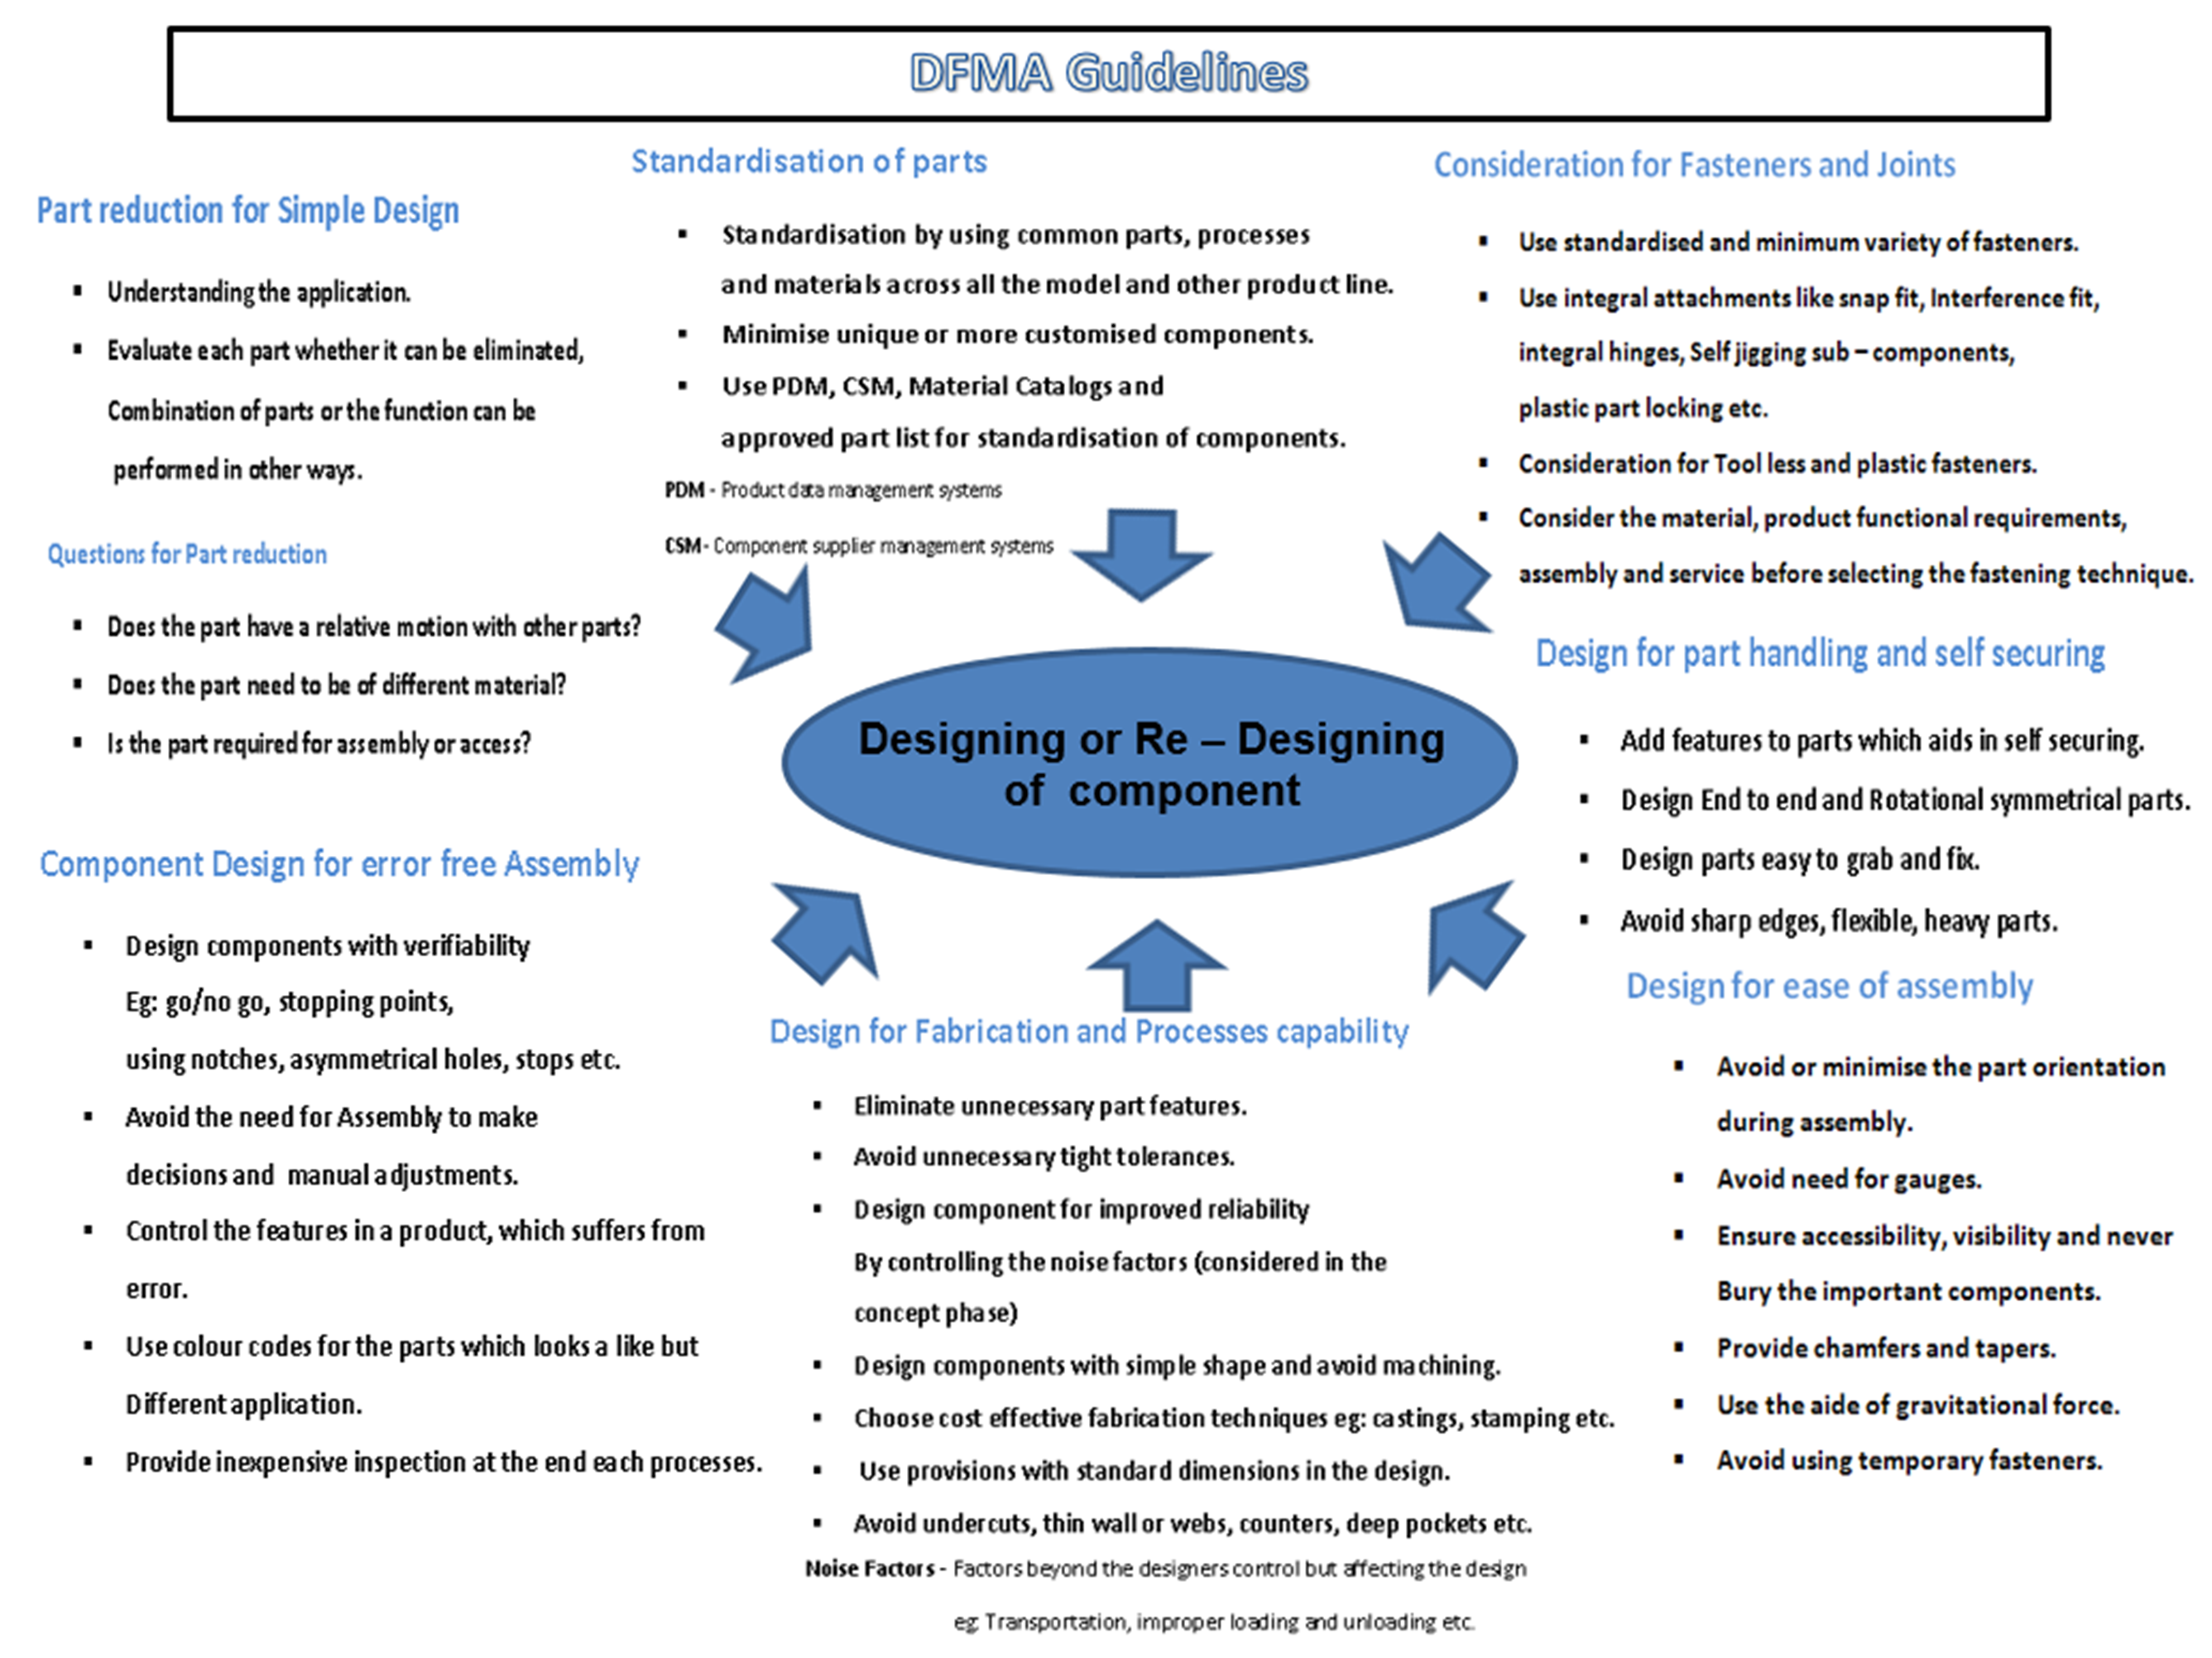
Design For Manufacture and Assembly(DFMA)
DFMA
Design for Assembly & Manufacture
DFA
Design for Assembly
Reducing product Assy cost.
Reduce the number of Assembly operations and make them easier to perform.
DFM
Design for Manufacture
Reducing overall part production cost.
Minimise complexity of manufacturing operations and make use of common datum features.
  Design for top down assembly
  Make parts self locating
  Try to design parts with symmetry
  Prevent stacked parts from getting stuck together
  Avoid parts that are difficult to handle
  In general, avoid adjustments. Adjustments compensate for poor design.

Slide 9
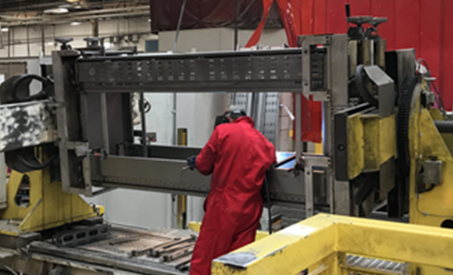
Deploying DFMA in Open rack
Basic rack structure already conforms to DFMA principles (small part count) but to achieve a Cpk >1.33 multiple fixtures are required.
Reduce fixtures and make parts self locating
DFA
Tag parts together to remove the need for fixtures
DFM
Tags to replicate critical equipment interface points.
Remove barriers for scalability
Outcome

Slide 10
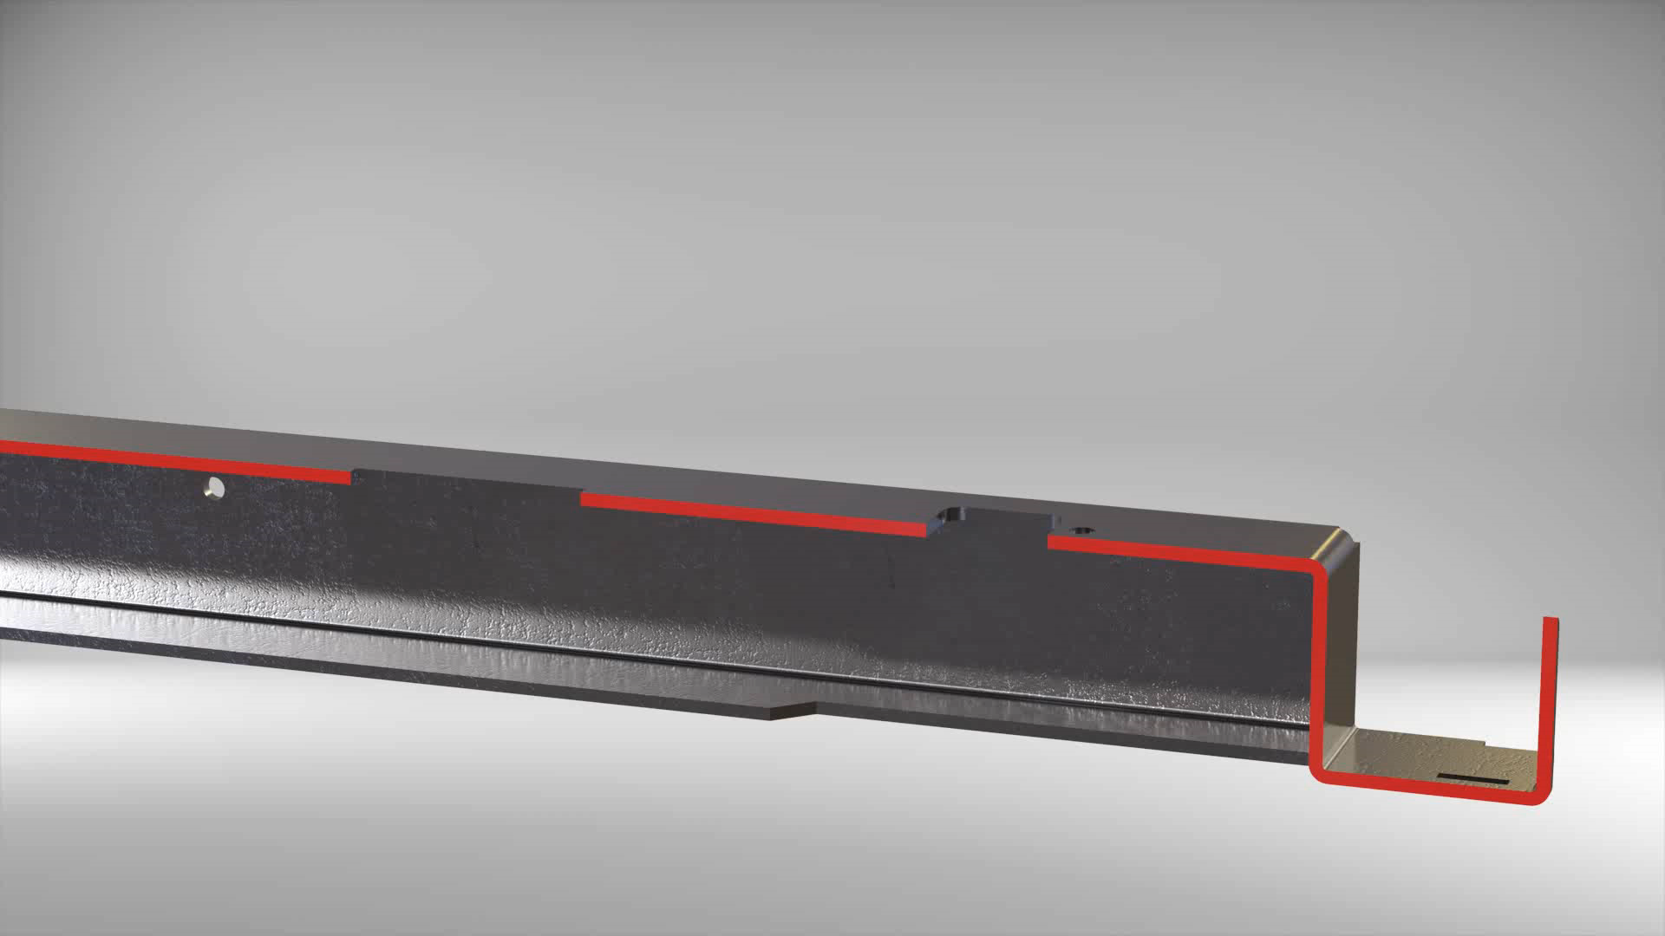
Deploying DFMA in Open rack
A
Single tag that fixes location Datum A
Floating Tag to aid orientation but not fix location.

Slide 11
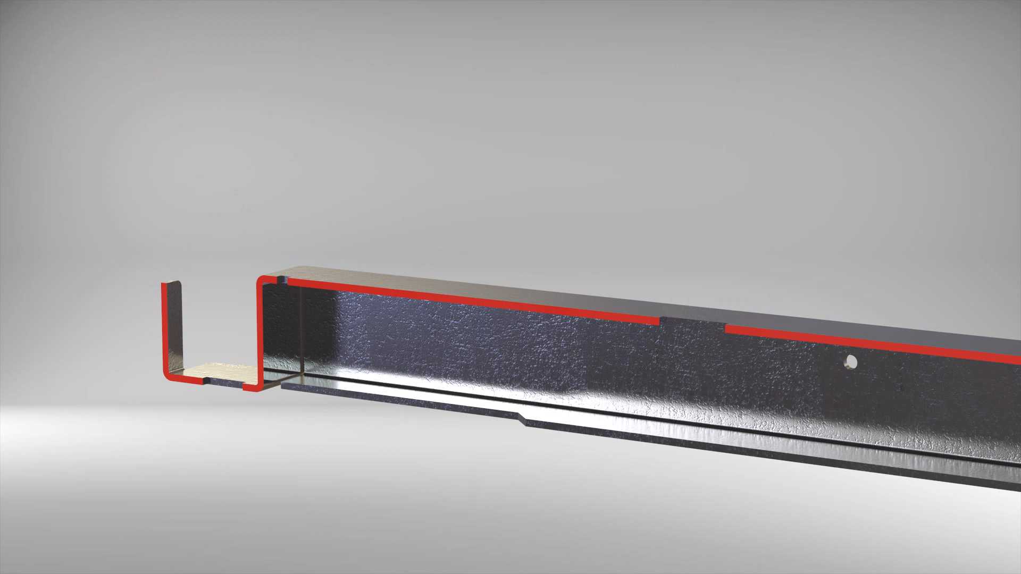
Deploying DFMA in Open rack
Single tag that fixes location Datum B
B
Floating Tag to aid orientation but not fix location.

Slide 12
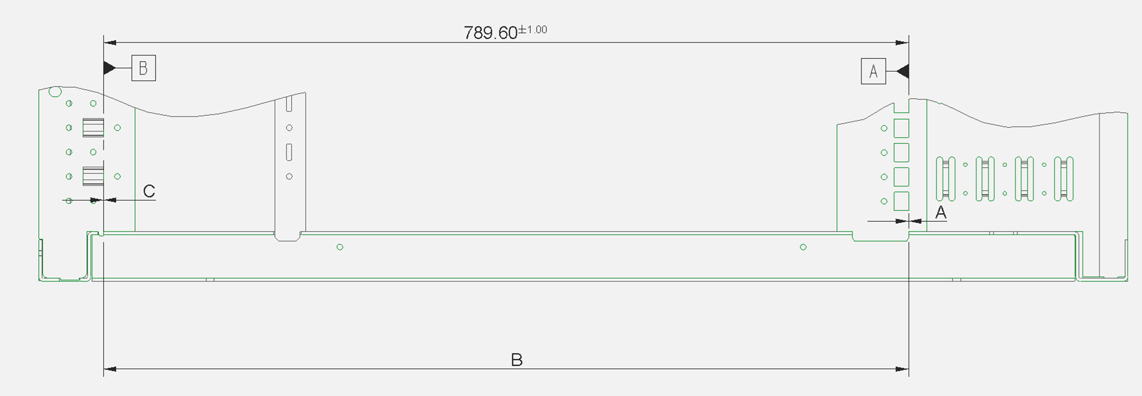
Deploying DFMA in Open rack
Tolerance loop analysis to reduce failures
.
Tolerance loop analysis to reduce failures
Predicts the number of failures using chosen method
  6 Sigma
  RSS
  Min/Max

Slide 13
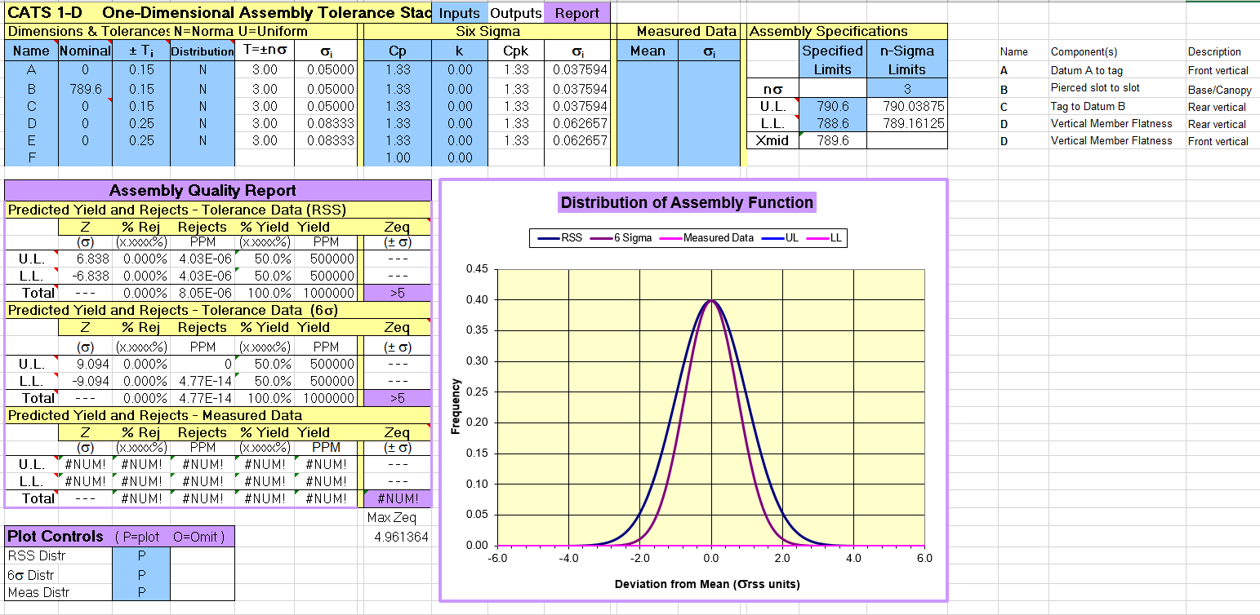
Deploying DFMA in Open rack
Tolerance loop analysis to reduce failures
.

Slide 14
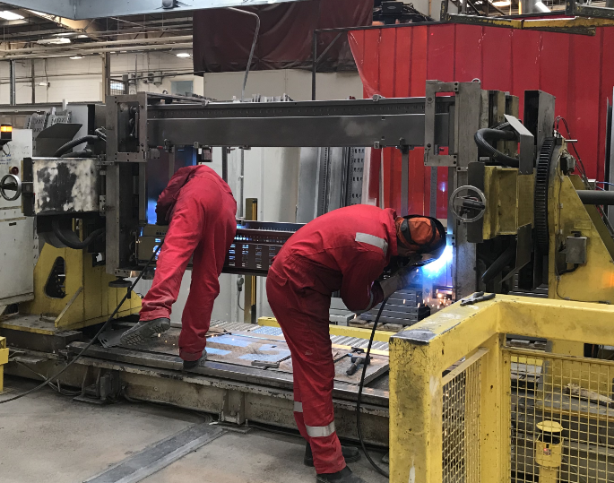
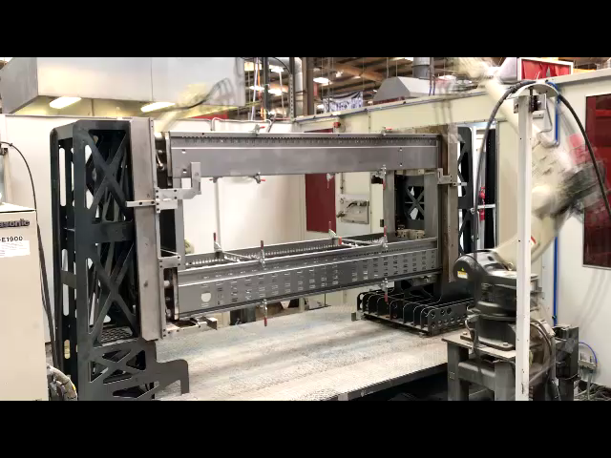
Outcome of this analysis
Simple Optimisation of the Open Rack through a DFMA lens has helped scale roll out. The future is open
Higher level of repeatability
Move away from manual processes
Waste is reduced

Slide 15
White paper submission
‘Optimisation of the Open Rack through a DFMA lens to help scale roll out’.
Available Mid 2018

