Slide 2
FBOSS operationalization
Nina Schiff
Software Engineer, Facebook Network Team
March 2018

Slide 3
Running a network at scale
Notes:
Most of us here are familiar with some of the ideas behind running a network

Slide 4
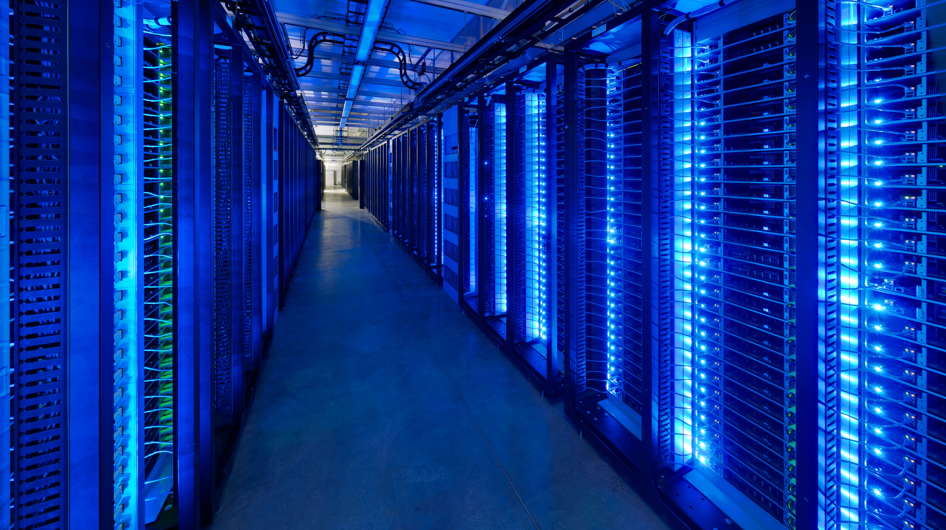
Running a network at scale
Notes:
But what does it mean to run one at scale?

Slide 5
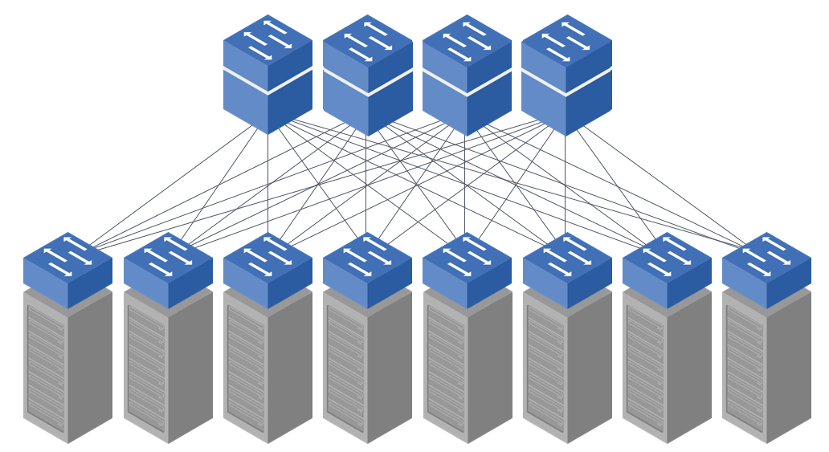
We run a hybrid network
Notes:
We have almost always had a network of different devices, from differenty vendors, with different roles and requirements.
Each of these devices on thgeir own is fine, but we’ve had to come up with new ways to manage all of these devices together.
We don’t care who the device is made by, for us, at this scale, it is simply a node in a much vaster overall network.
We don’t want to have to worry about vendor, specifics, we want to get on with the job of running and growing our network to meet Facebook’s needs.
In order to run our network effectively, every device in it, regardless of vendor, needs to support a couple of basic operations

Slide 6
We run a hybrid network
Device lifecycle includes:
Updates
Config changes
Notes:
This includes things like updating their software and applying new configs

Slide 7
We run a hybrid network
SW1# conf t
SW1(config)# boot system flash:vendor_image
SW1(config)# end
SW1
Notes:
Updates and config changes happen very infrequently, which may explain why they’re a timeconsuming and disruptive thing to apply.
We get new images from vendors and flash the entire device, replacing it’s current image with the new one. Doing this takes the device off the network for some time.

Slide 8
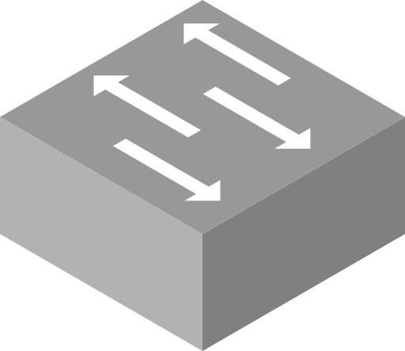
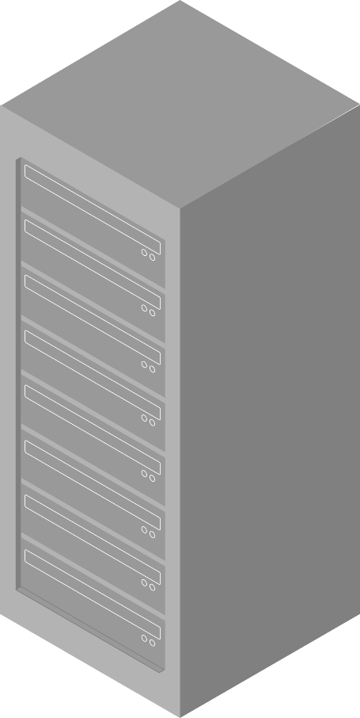
Stopping traffic gracefully
Notes:
We’d prefer to do this as gracefully as possible, no dropped packets, no unnecessary disruption.
In order to do this, we go through a process of draining the device.
For top of rack switches, we use automation to move all running services out of the rack – this means there is no longer anything sending or receiving packets.

Slide 9
Stopping traffic gracefully
Notes:
This is much easier for our chassis switches, here we can just change our bgp policies so that the switch is no longer advertised.
Both of these techniques ensure that when a device is removed from the network, this is done with as little disruption as possible – the rest of the network carries on, mostly unaffected.

Slide 10
Starting traffic gracefully
Notes:
Once maintenance or updates are done, we reverse this process. This involves bringing the switch back up, testing connectivity and then finally, changing bgp configs so it starts to serve traffic once again.

Slide 11
We run a hybrid network
Device lifecycle includes:
Updates
Config changes
Retrieving switch state
Notes:
We also need to be able to examine switch state. This can be done by humans, as well as through automated systems.
As I mentioned before, we have a lot of devices from different vendors running in our network, each with their own flavour of CLI. In order to deal with this, we’ve built an abstraction layer over these differences

Slide 12
We run a hybrid network
fcr> show lldp neigh
.. .
https://github.com/facebookincubator/FCR
Notes:
We recently opensourced the Facebook Command Runner, or fcr for short.
This provides a single unified interface to run commands on any device.
This abstracts away the specifics of devices, providing network operators with a single way to access information
But we don’t just access this information manually – we also use it in automated systems to see what’s broken or in a bad state

Slide 13
We run a hybrid network
Device lifecycle includes:
Updates
Config changes
Retrieving switch state
Breakages + remediation
Notes:
Which brings us onto the next stage in a device lifecycle – which is what happens when things break

Slide 14
Degraded devices
Notes:
Typically, we’ll be able to tell something is wrong through the metrics we collect, this will raise

Slide 15
Degraded devices
Notes:
An alert, and someone will

Slide 16
Degraded devices
Notes:
Have to figure out what’s gone wrong

Slide 17
Degraded devices
Notes:
And fix or replace the faulty hardware.
And this works great, when you only have a couple of devices

Slide 18
Degraded devices
Notes:
But with a very big network, this quickly gets out of hand – and the bit that isn’t scaling, is the bit with humans

Slide 19
Degraded devices
Notes:
Which means we have to automate the classification and remediation steps of this process.

Slide 20
FBAR
Notes:
Which means we have to automate the classification and remediation steps of this process.
We use a tool called fbar, the facebook auto-remediation service.
It allows us to do exactly this, define metrics and alerts to watch, steps to classify problems, and finally, the ability to perform operations to fix whatever it broken
This is another place we use draining extensively – often we have devices in degraded states, they’re not down, but we want to fix things before they get worse. Our automation allows us to drain them as soon as we identify a problem, fixes the problem and then brings them back online

Slide 21
FBAR
Notes:
Which means we have to automate the classification and remediation steps of this process.
We use a tool called fbar, the facebook auto-remediation service.
It allows us to do exactly this, define metrics and alerts to watch, steps to classify problems, and finally, the ability to perform operations to fix whatever it broken
This is another place we use draining extensively – often we have devices in degraded states, they’re not down, but we want to fix things before they get worse. Our automation allows us to drain them as soon as we identify a problem

Slide 22
FBAR
Notes:
fixe the problem

Slide 23
FBAR
Notes:
And gracefully bring them back up

Slide 24
We run a hybrid network
Device lifecycle includes:
Updates
Config changes
Retrieving switch state
Breakages + remediation

Slide 25
Running FBOSS at scale
Notes:
A quick recap for anyone in the audience who isn’t familiar with wedge and fboss

Slide 26
Wedge + FBOSS
Micro server
ASIC
OCP Micro Server
BGP daemon
FBOSS Agent
OpenNSL
Open BMC
Linux
Notes:
The userver runs our standard linux distribution, and in many ways, looks exactly like a server.
The FBOSS agent is the custom software that manages state for the switch and programmes route and forwarding information and settings into the ASIC.
It runs on the userver alongside a bgp implementation, which implements the well known protocol and feed route information to the fboss agent.

Slide 27
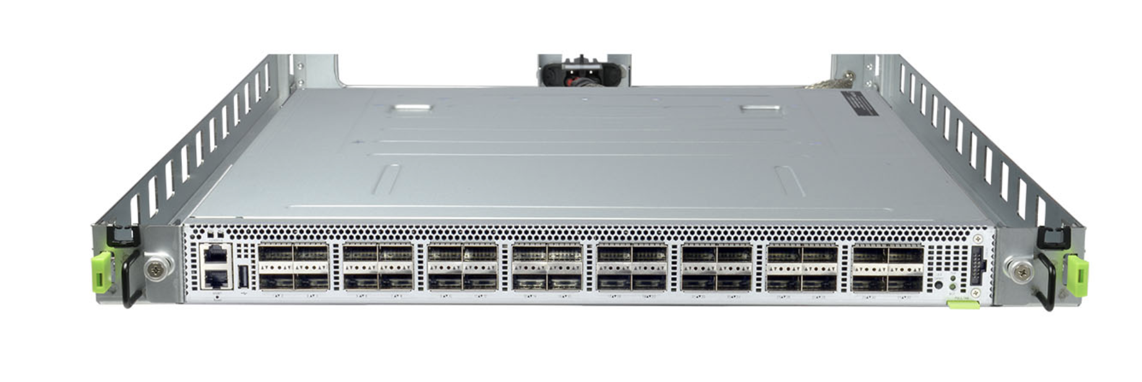

Slide 29
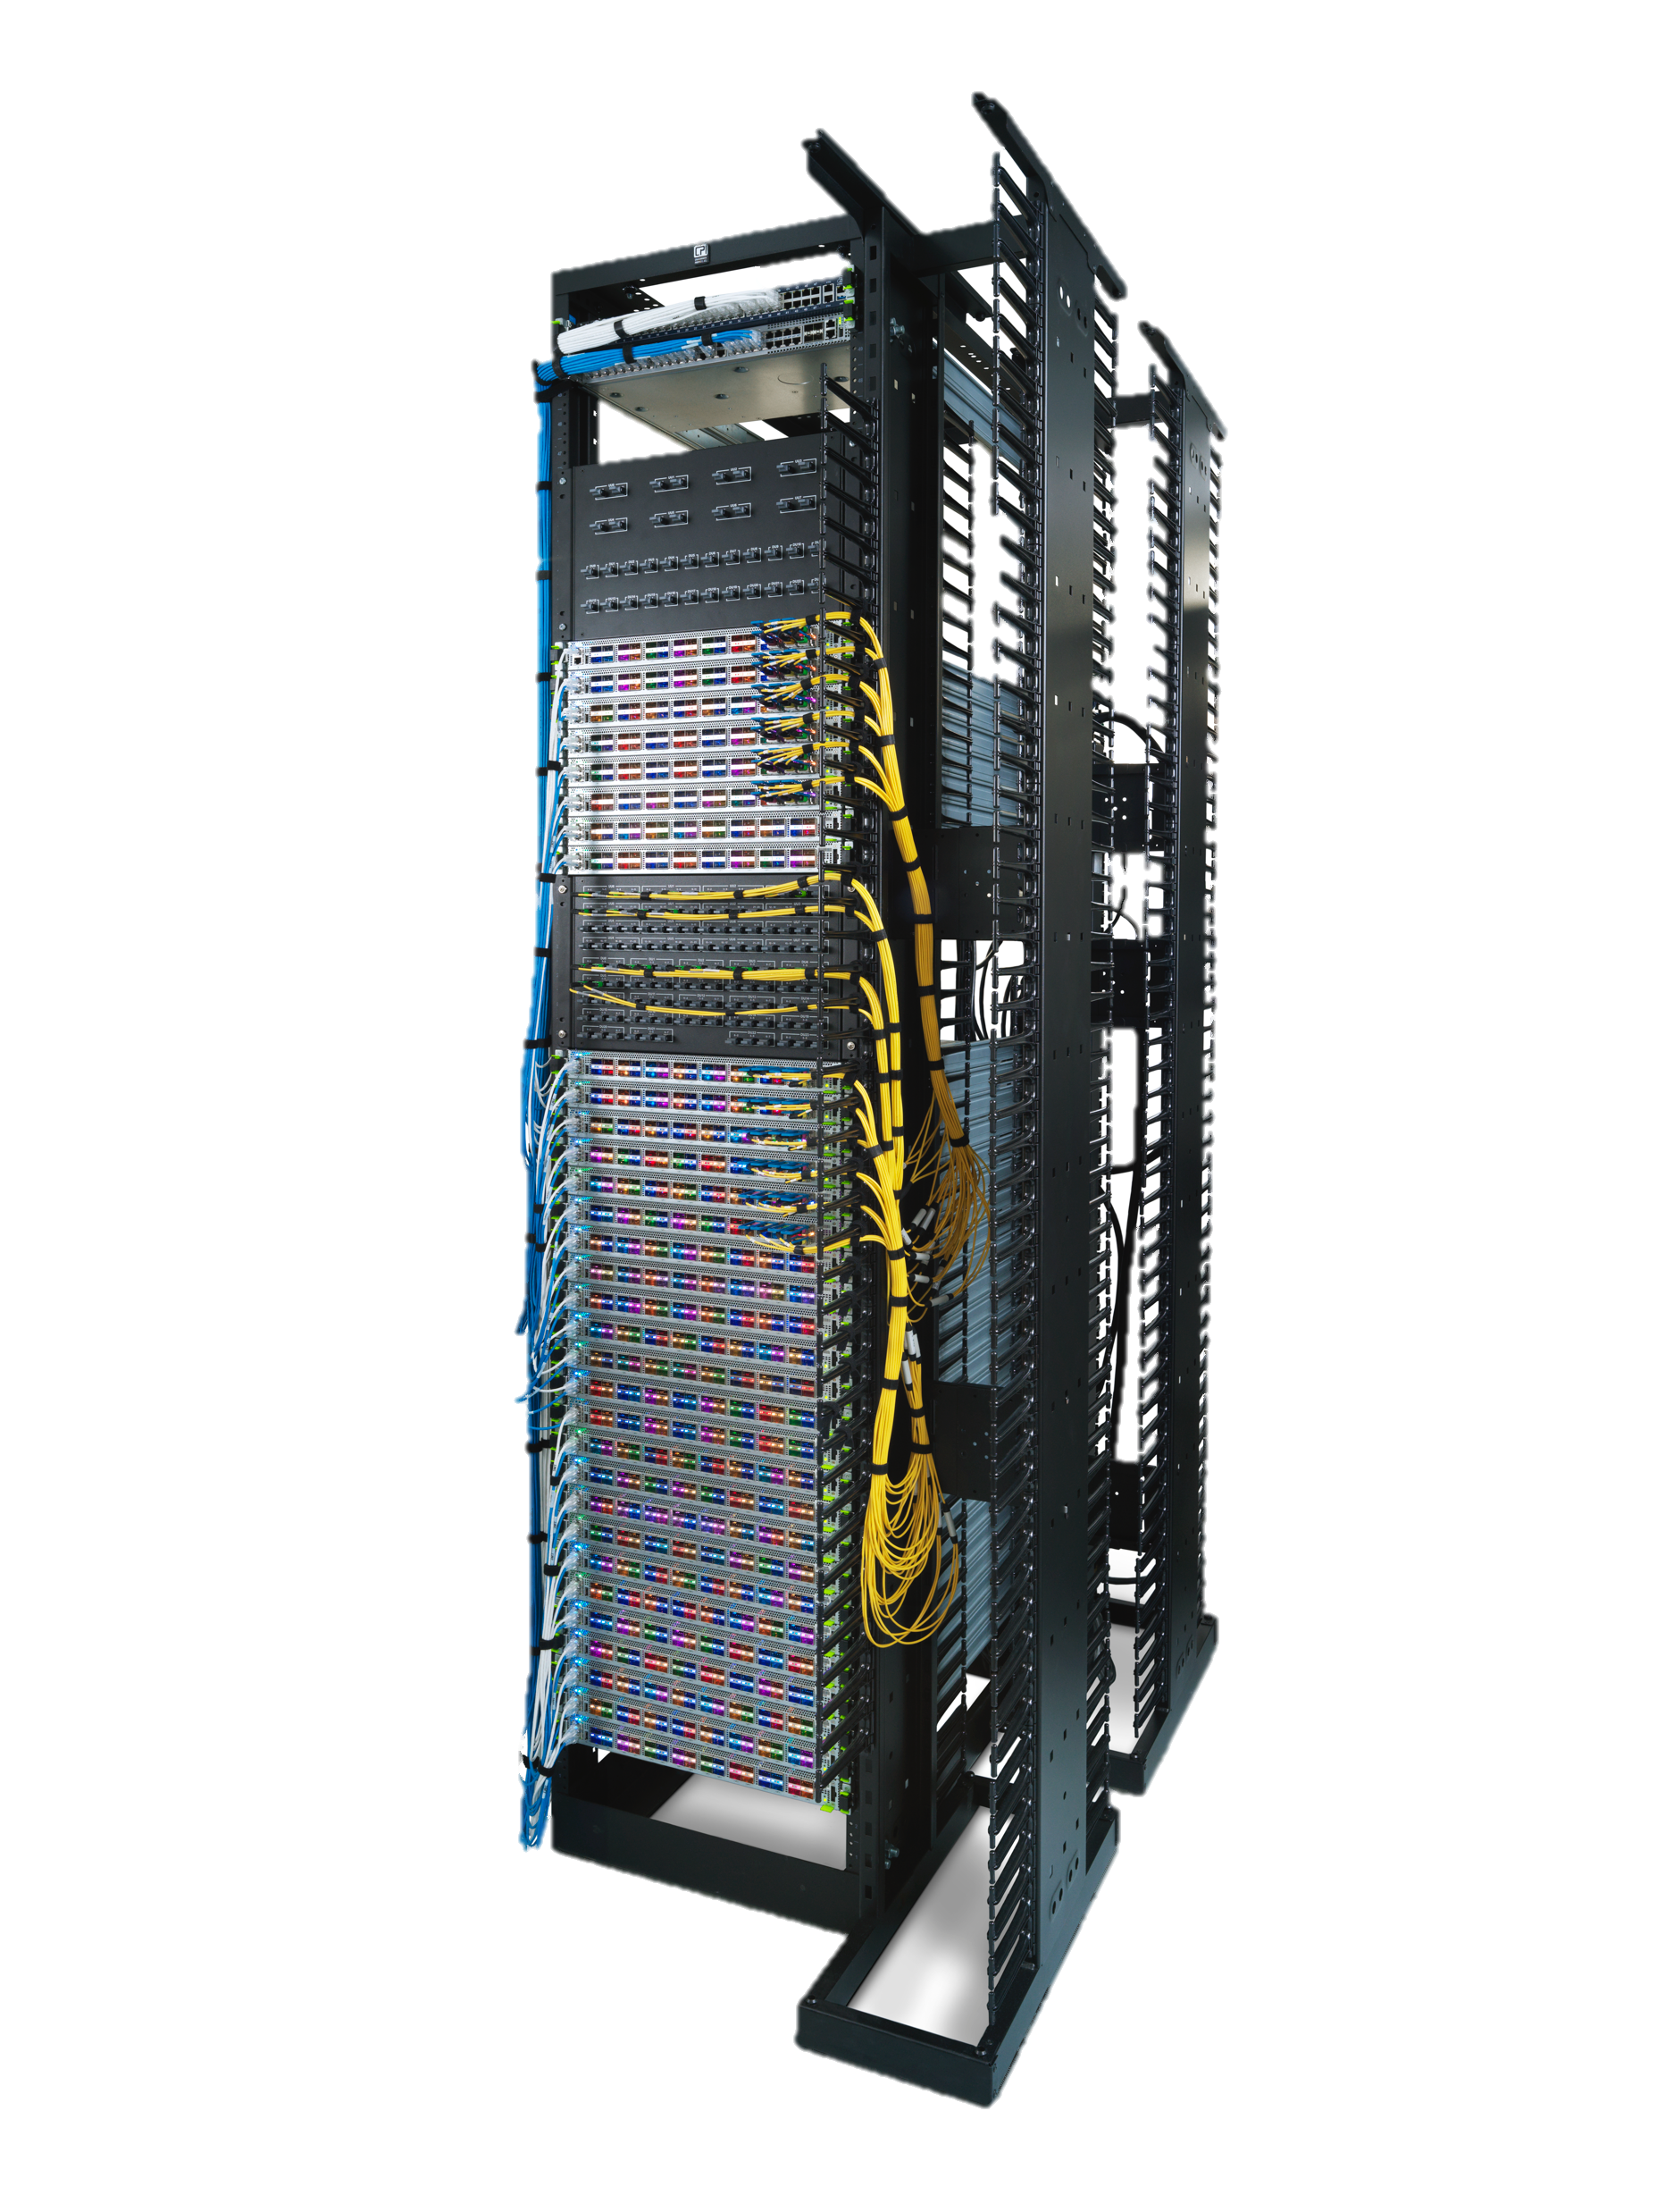

Slide 30
We run a hybrid network
Device lifecycle includes:
Updates
Config changes
Retrieving switch state
Breakages + remediation

Slide 31

Switching as a service
Continuous forwarding
Regular SW updates
Move fast!
Notes:
We wanted to do regular updates, on the order of weeks, rather than years as we believed this would help us move much faster. In order to do this, and not annoy all network users, we needed to be able to do this without disrupting traffic – in other words, continuously forward traffic, even during an update.

Slide 32
Why continuous forwarding?
Number 0f FBOSS devices that are Top of Rack
Lots*
* Proportions for effect, not accuracy
Notes:
So, you may be asking, why do we even need to worry about continuous forwarding? Why not just drain the switch, update and then bring it back?
Unfortunately, we have no redundancy at the top of rack level, and the vast majority of our fboss devices are indeed TORs.
This means that in order to drain the switch, we take down all traffic to services in the rack. Doing this requires us to drain traffic from all the servers running there. Which requires us to work with all the various service owners who run software on those servers. Which takes a long time.
But! We want to update often, which means taking the switch down even temporarily is a non-starter.

Slide 33
Switching as a service
Continuous forwarding
Regular SW updates
Move fast!
Notes:
In order to do this, we take advantage of a feature from our Broadcom chip, called

Slide 34

Switching as a service
Continuous forwarding
Regular SW updates
Move fast!
Notes:
Warm boot.
This allows us to restart our binary (and update it) without changing the forwarding state of the chip, essentially allowing it to continue forwarding while we change the running binary.
Okay, so we’re now able to do updates, without disrupting traffic. But how exactly do we do these? Or to rephrase, how do we make sure doing this isn’t going to break everything?

Slide 35
Switching as a service
Continuous forwarding
Regular SW updates
Move fast!
Notes:
Okay, so we’re now able to do updates, without disrupting traffic. But how exactly do we do these? Or to rephrase, how do we make sure doing this isn’t going to break everything?

Slide 36
Deploying safely
Notes:
We do this by canarying our changes.

Slide 37
Deploying safely
Notes:
We have a daily canary, which takes the newest code and deploys it onto a very small number of switches. This is monitored and we receive alarms for any dicrepencies seen in our health metrics. Once we’ve validated the version on these switches, we then prepare it for wider release.
It’s worth mentioning that we run the exact same software on all of our devices, regardless of their role in the network.

Slide 38
Deploying safely
Notes:
This applies the same principal, taking the new binary and canarying it on a small percentrage of hosts in the least sensitive parts of our network.

Slide 39
Deploying safely
Notes:
This applies the same principal, taking the new binary and canarying it on a small percentrage of hosts in the least sensitive parts of our network.

Slide 40
Deploying safely
Notes:
Once we’re comfortable with this, we continue to a larger percent, all the while continueing to monitor the network for signs of disruption.

Slide 41
Deploying safely
Notes:
We repeat this canary, monitor, repeat process until the new version is rolled out everywhere. And then, of course,

Slide 42
Deploying safely
Notes:
We start the process from the beginning again.
So I mentioned that we monitor our releases, and this is worth diging into a bit. We have specific dashboards

Slide 43
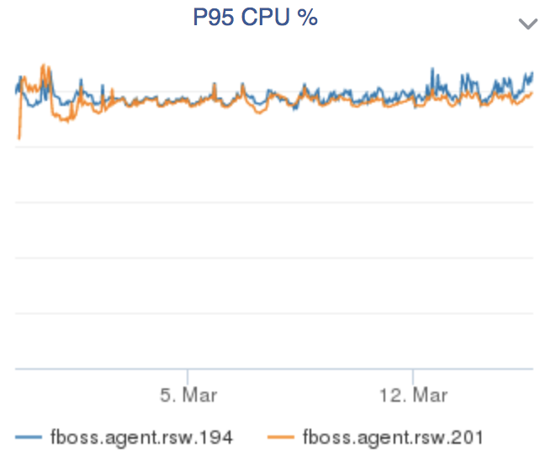
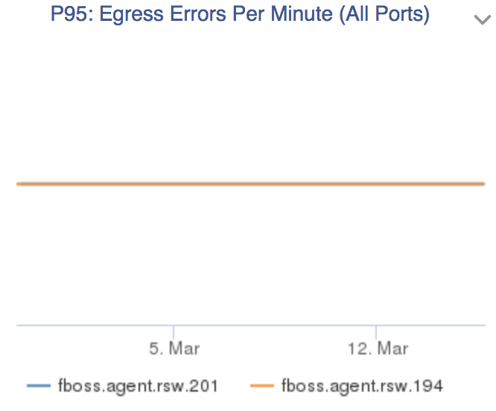
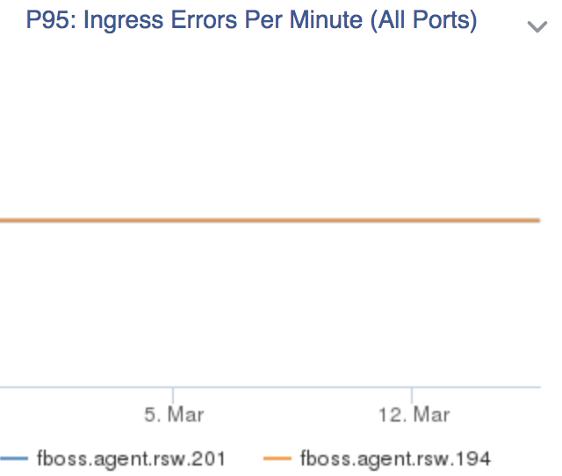
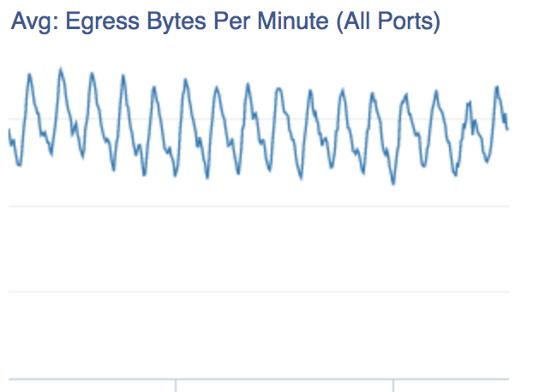
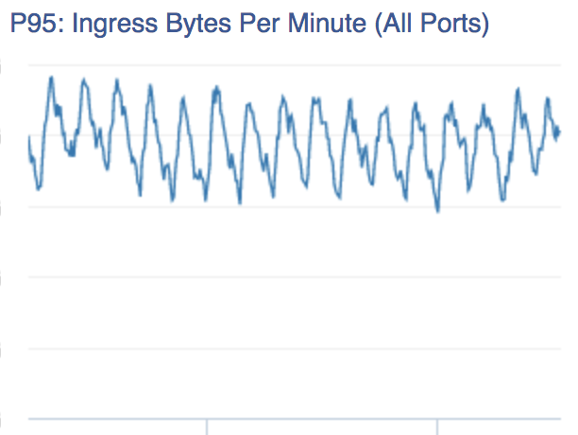
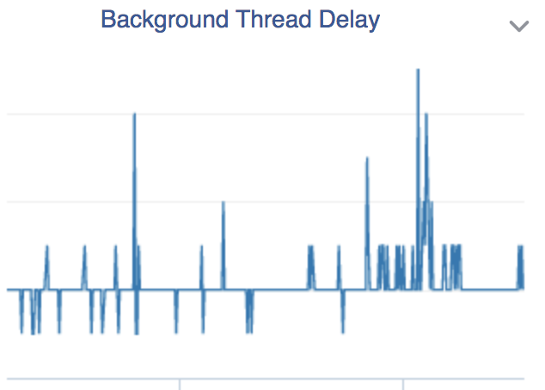
Deploying safely
Notes:
For our various deployment tiers. These allow us to quickly guage the state of the release. We have this set up to compare performance of the new release with that of the old.
We don’t just rely on humans though. We have alarms and metrics set up so that we can have automated systems deal with any outages we see in the network.
These are useful during deployment, but equally so during normal network operation.

Slide 44
Deploying safely
Notes:
And we have incredibly strict margins for error when deploying.

Slide 45
Deploying safely
Notes:
For transient traffic disruptions, like a subsecond period where we can’t contact hosts in the rack, we consider a deployment a failure if we

Slide 46
Deploying safely
Notes:
Have more than 1% of our fleet experience these errors.
For disruptions longer than that, or that cause route churn, we stop deployments if more than

Slide 47
Deploying safely
Notes:
0.1% show this.
Despite these strict margins, and indeed, because of them, we’re able to confidently and reliably deploy every 2 weeks. This staged roll out helps us catch issues fast and roll our changes with much more confidence.
Observant people in the audience may have noticed that I’ve spoken about how we deploy, but not why we need to deploy so often

Slide 48
Switching as a service
Continuous forwarding
Regular SW updates
Move fast!
Notes:
The basic premise here is, the more often we deploy, the faster we can get features and fixes out and the faster we can move overall
We don’t have to get everything perfect for one final release, we can release incrementally, learning from the results of these deployments and improving the overall feature as we go.

Slide 49
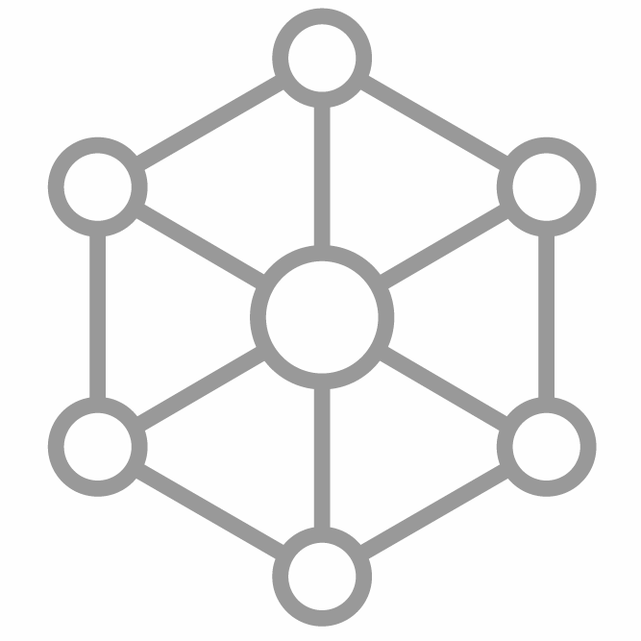
Moving fast!
New protocols
+ topologies
Notes:
We can do things like play with new routing protocols or topologies with ease – adding and releasing these features takes weeks instead of years. We can quicvkly prove or disprove hypothoses.

Slide 50

Moving fast!
New protocols
+ topologies
Comprehensive monitoring
Notes:
We can customize and improve our monitoring and the information about the network that we’re able to retrieve. We can easily increase the resolution of our metrics or start to track some new counter as we need it. And all of this integrates into all of the existing FB infrastructure perfectly – because we control the flow of output from the chip up.

Slide 51
Moving fast!
New protocols
+ topologies
Comprehensive monitoring
Smarter operational tools
Notes:
And this, allows us to build better tools to do the work of managing our network, so that humans don’t have to.
Remember how Pablo mentioned how we employ automation to remediate our network without human involvement?
We’re able to fine tune and improve our automation based on our needs, so that new issues don’t have to require humans to resolve them.

Slide 52
Moving fast!
New protocols
+ topologies
Comprehensive monitoring
Smarter operational tools
Disaster
recovery
Notes:
And finally, there’s planning for the unthinkable.
With a network at the scale of Facebook’s, large scale outages become a question of when, rather than if.
Because we already have all the infrastructure in place for fast deployments, we’d be able to roll out a fix in an hour or so, with as little impact as possible.
Not only that, but our entire deployment process is set up to find these issues before they’re everywhere in the fleet.

Slide 53
FBOSS’ place in this hybrid network
Other
FBOSS
Top of Rack Switches*
Chassis Switches*
* Proportions for effect, not accuracy
Notes:
Okay, so now that I’ve spoken a bit about how we have operationalised fboss, let’s zoom out a bit and look at how it fits into the FB network.
FBOSS now makes up the vast majority of rack switches, and backpack and the recently announced 24-device FA chassis switches are being deployed at an increasingly fast rate.
Which means that FBOSS already makes up a considerable amount of our hybrid network, and that percentage is just growing.
We’ve described how we have all these tools to seemlessly integrate multiple device types into a single network.

Slide 54
So who actually operates these devices?
Notes:
But we haven’t yet really spoken about who actually is responsible for these devices in production.
With vendor devices, it’s pretty clear - network engineers control, monitor and configure them.
With FBOSS, we have more options. The most traditional would have been to treat FBOSS and Wedge like a vendor.

Slide 55
Notes:
We create the hardware and software, and then,

Slide 56
Notes:
hand it off to network engineers who then run the network as a whole. They deal with failures, we work on the next version.
But! We already knew how to do that. We wanted to try something different and see if it could work better for us.

Slide 57
Oncall responsibilities
Network engineers are oncall for (pretty much) everything
Notes:
So, as I mentioned, with vendor devices, typically network engineers are responsible for their operation and making sure they stay up.
What if, instead, those of us who created the devices, also took responsibility for them in production?

Slide 58
Oncall responsibilities
Network engineers are oncall for everything
FBOSS Software engineers are oncall for FBOSS devices
Notes:
By that I mean, FBOSS software engineers are responsible for the health of FBOSS devices in production. And not only that,

Slide 59
Oncall responsibilities
Network engineers are oncall for everything
FBOSS software engineers are oncall for FBOSS devices
Wedge hardware engineers are oncall for Wedge devices
Notes:
But we have hardware engineers oncall for these devices as well.
There’s no throwing anything over the wall here. The people who create the devices and the software that runs on them, are the ones who have to see them through production.

Slide 60
Collaboration
People who can fix the issues, also feel the impact
Network engineers work with us to define goals
We work with them to improve workflows
Notes:
To some, this may seem like unneccessary load on software and hardware engineers, who have better things to do than be oncall for this stuff.
But these oncalls actually do a tremendous amount to help define and orient our goals towards what will be most impactful.
As a software engineer, if you’re oncall, and the same thing keeps breaking, it becomes important to you to fix it for good, so you don’t have to keep dealing with it. We don’t need some other person to convince us of the importance of fixing it, because we already know!

Slide 61
Collaboration
People who can fix the issues, also feel the impact
Network engineers work with us to define goals
We work with them to improve workflows
Far more stable devices
Notes:
And this all leads to, far more stable devices
Which in turn, helps

Slide 62
Collaboration
People who can fix the issues, also feel the impact
Network engineers work with us to define goals
We work with them to improve workflows
Far more stable devices
Move faster
Scale out further
Notes:
Us to move faster with more confidence and continue to grow the network in order to meet the demands of the Facebook ecosystem.

Slide 63
Notes:
At Facebook, wedge and FBOSS have not just been about a different way to design switches, but rather, a whole new way to operate a network.
And so far, it seems to be working.

